Slide 1
Creating a Notation Program in Forty-Five Minutes
Floyd Richmond
10:30a, October 29, 2016
ATMI/CMS Santa Fe, NM
frichmond@valleyforge.edu
Download Source Files and Presentation:
HTTP://FLOYDRICHMOND.COM/ATMI2016

Slide 2
For whom is this presentation designed?
People who appreciate the interactive power of Javascript and web-based apps, and especially those inclined to experiment themselves.

Slide 3
For whom is this presentation NOT designed?
Those expecting to see how to create notation program with all the features of modern notation software.
Those who find that existing notation programs fulfill their needs, and want to use them as is.
  Finale
  Sibelius
  NoteFlight
  Notion
  MuseScore
  Flat.io
  Verovio

Slide 4
For whom is this presentation designed?
Those working in HTML and Javascript and who want to create . . .
  custom notation programs for creative web activities.
  custom notation-based activities for interactive web sites
  custom demonstrations of music theory content
  graded templates for learning management systems.

Slide 5
Existing Notation Programs
  Finale
  Sibelius
  NoteFlight
  Notion
  MuseScore
  Flat.io
  Verovio

Slide 6
For whom is this presentation designed?
EXAMPLES:
http://floydrichmond.com/classwork/annekramer/index.html
http://floydrichmond.com/usetech
http://floydrichmond.com/notation

Slide 7
Components of a notation program?
Input/output area where the entries can be viewed.
Graphic Images for use in entry.
Input functions for mouse, and keyboard actions.
Command interface for note entry and editing.
Drawing functions for placing notes and symbols.
Record keeping for saving the score.
Functions for playing the score.

Slide 8
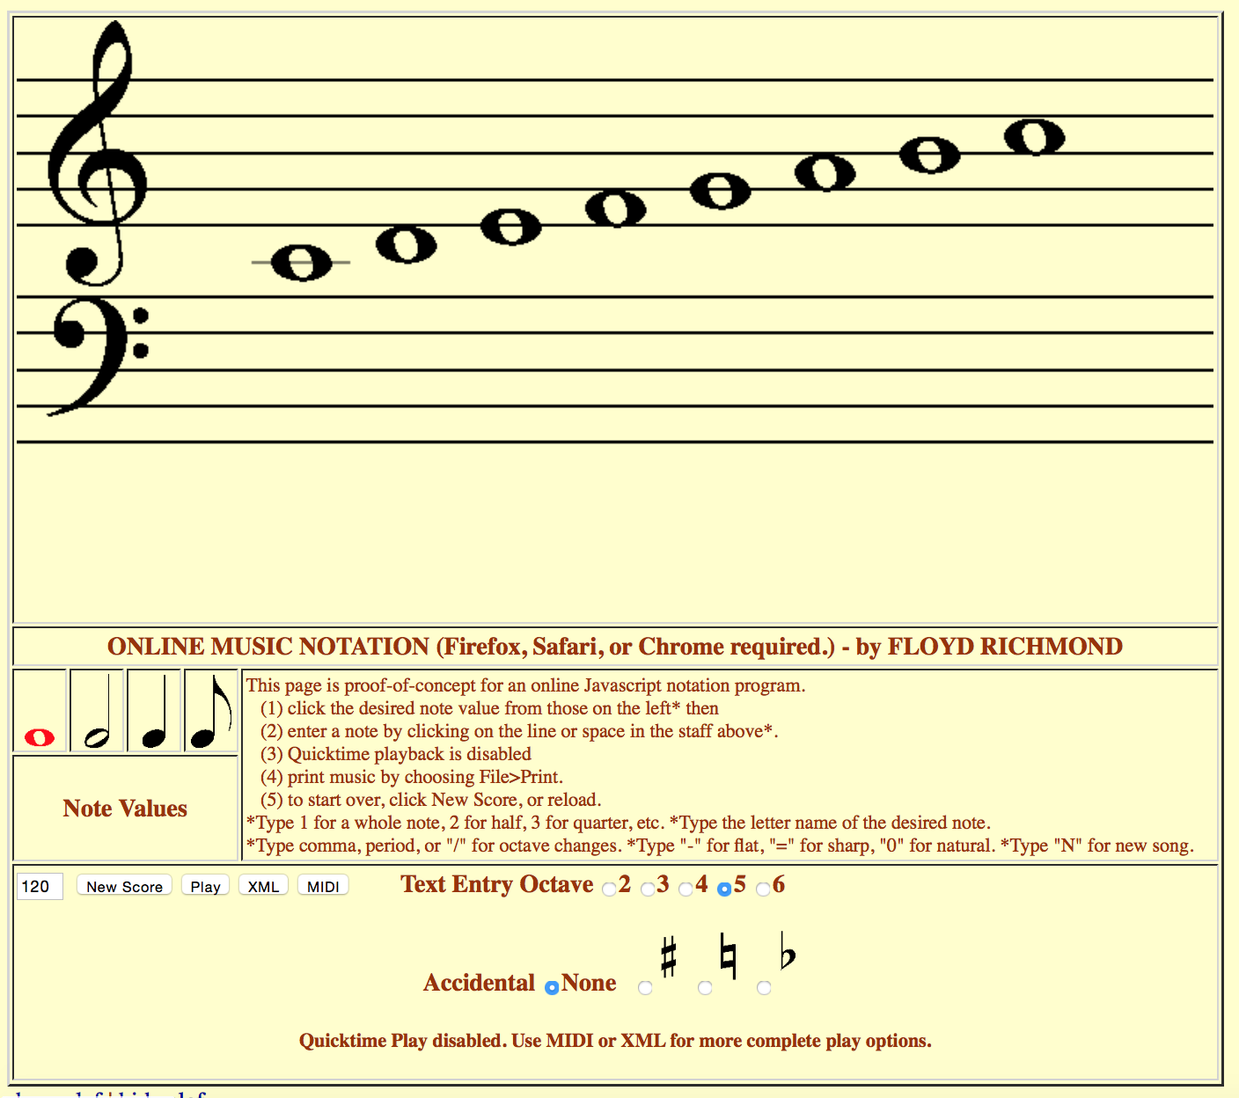
Components - Input/output area
HTML 5 introduced the canvas element which made notation much easier.
The Input/Output area is initially created through . . .
  Canvas
  Forms
  HTML/JavaScript

Slide 9
Components - Graphic Images
Modern notation programs use fonts to draw musical symbols. Web pages can use the same strategy, but due to the difficulty of being confident that a specific musical font is available, and the tendency of web pages to substitute fonts, drawing musical symbols from existing images is a better option.

Slide 10
Components - Graphic Images
arrow.gif
arrowred.gif
bassclef.gif
blank.gif
eighthinv.gif
eighthup.gif
flat.gif
flatinv.gif
flatr.gif
halfinv.gif
halfup.gif
natural.gif
naturalr.gif
quarterinv.gif
quarterup.gif
sharp.gif
sharpinv.gif
sharpinvr.gif
sixteenthinv.gif
sixteenthup.gif
staff.gif
trebleclef.gif
whole.gif
wholeinv.gif

Slide 11
Components - Graphic Images
Drawing Functions:
Created functions for drawing shapes, based on the input supplied to the function and program variables.
Anytime a drawing representing an entry or editing is done, the song data is updated also.

Slide 12
Components - Graphic Images
Program Functions
newSong()
drawGrandStaff()
drawNote(xx,yy)
convertLocToNoteName ()
resetTools ()
selectTool (x)

Slide 13
Components - Command Interface
Tools and commands for editing – every notation program has a toolset that you select by typing or clicking. Once a tool is selected or you are in a given editing mode, you continue to build your score.

Slide 14
Components - Command Interface
Implemented commands:
Type “N” for a New Score (or reload, or use “New Score” button.
Select rhythms for entry as follows (or click desired rhythm).
  1 = whole note, 2 = half, 3 = quarter, etc.
Enter a note by typing its letter name (or click its staff location)
Chance octaves as follows (or click octave selection button):
  Comma = octave 3, period = 4, “/” = 5
Select Accidentals as follows (or click accidental selection button):
  "0" for natural, "-" for flat, "=" for sharp
Type "N" for new song.
Print: File>Print.

Slide 15
Components - Command Interface
Input functions for mouse and keyboard actions.
Keyboard listener
Mouse listener

Slide 16
Components - Command Interface
Program Functions
newSong()
selectTool (x)
resetTools ()
convertLocToNoteName (xx,yy)
whichKey(km)
getMousePosition(e)

Slide 17
Components - Saving the score.
Each note entry is immediately converted into a MIDI and XML version and the results are updated into a field on screen.

Slide 18
Components - Saving the score.
saveMsg
getMsg

Slide 19
Components - Playing songs
When this web page was started, Flash was the best way to play composed melodies in a browser.
I was searching for an alternative and initially tried embedded Quicktime movies for playback. Results were ok for simple melodies and harmonies, so long as the tempos were slow, but it had it’s issues. For example, a computer browser could preload all sounds, but iOS would only load one at a time.

Slide 20
Components - Playing entries
n24.mp4
N25.mp4
N26.mp4
N27.mp4
N28.mp4
N29.mp4
N30.mp4
N31.mp4
N32.mp4
N33.mp4
N34.mp4
N35.mp4
N36.mp4
N37.mp4
N38.mp4
N39.mp4
N40.mp4
N41.mp4
N42.mp4
N43.mp4
N44.mp4
N45.mp4
N46.mp4
N47.mp4
N48.mp4
N49.mp4
N50.mp4
N51.mp4
N52.mp4
N53.mp4
N54.mp4
N55.mp4
N56.mp4
N57.mp4
N58.mp4
N59.mp4
N60.mp4
N61.mp4
N62.mp4
N63.mp4
N64.mp4
N65.mp4
N66.mp4
N67.mp4
N68.mp4
N69.mp4
N70.mp4
N71.mp4
N72.mp4
N73.mp4
N74.mp4
N75.mp4
N76.mp4
N77.mp4
N78.mp4
N79.mp4
N80.mp4
N81.mp4
N82.mp4
N83.mp4
N84.mp4
N85.mp4
N86.mp4
N87.mp4
N88.mp4
N89.mp4
N90.mp4
N91.mp4
N92.mp4
N93.mp4
N94.mp4
N95.mp4
n96.mp4

Slide 21
Components - Playing entries
Apple removed plug-ins from it’s browsers recently, so . . .
There is now an Audio Context component for Safari, Firefox and Chrome.
Apple’s documentation is here: Playing Sound with the Web Audio API

Slide 22
Components - Playing entries
playArray()
playNote(n)

Slide 23
Entire List of Program Functions
newSong()
drawGrandStaff()
saveMsg
getMsg
convertLocToNoteName
drawNote(xx,yy)
whichKey(km)
getMousePosition(e)
resetTools ()
selectTool (x)
whatbrowser()
playArray()
playNote(n)

Slide 24
Creating a Notation Program in Forty-Five Minutes
Floyd Richmond
10:30a, October 29, 2016
ATMI/CMS Santa Fe, NM
frichmond@valleyforge.edu
Download Source Files and Presentation:
HTTP://FLOYDRICHMOND.COM/ATMI2016

