Slide 1
open Education Resources
Dr. C. Floyd Richmond
Tarleton State University
crichmond@tarleton.edu
NYSSMA
Rochester, NY
1:15 December 2, 2023
http://floydrichmond.com/nyssma2023
http://musictheory.tech/
https://www.tarleton.edu/performingarts/music/

Slide 2
Tarleton State University
Texas A&M University
System Founding Member

Slide 3
Tarleton State University
Dr. James Hurley, President
John Tarleton, Founder

Slide 4
Tarleton State University
Concert Ensembles

Slide 5
Tarleton State University
Bachelor of Arts
  General Music
  Music Business
Bachelor of Music
  Music Education
  Performance
  Jazz
  Musical Theater
Masters of Music Education

Slide 6
Tarleton State University
Masters of Music Education
  Entirely online
  Work at your Convenience
  8-week Classes
  Starting in January
    Technology in the Music Classroom
    Research

Slide 7
open Education Resources
Dr. C. Floyd Richmond
Tarleton State University
crichmond@tarleton.edu
NYSSMA
Rochester, NY
1:15 December 2, 2023
http://floydrichmond.com/nyssma2023
http://musictheory.tech/
https://www.tarleton.edu/performingarts/music/

Slide 8
Music Theory:
A Thorough and Fast-Paced Review
Of Theory I, II, III, and IV
by
Dr. C. Floyd Richmond
Author of Alfred’s MusicTech Series,
Composing Music with Notation
© 1996 -2023 C. Floyd Richmond

Slide 9
Music Theory:
A Thorough and Fast-Paced Review
Of Theory I, II, III, and IV
About this Project:
https://floydrichmond.com/nyssma2023/overview.mp4

Slide 10
Music Theory:
A Thorough and Fast-Paced Review
Of Theory I, II, III, and IV
https://musictheory.tech/

Slide 11
Music Theory:
A Thorough and Fast-Paced Review
Of Theory I, II, III, and IV
Available for educational use by students and teachers at no cost so long as
They link to the original source at http://musictheory.tech/.
Existing copyright notices are not removed.
These terms of distribution are not modified.
Concerns may be reported to editor@musictheory.tech.
Derivative editions are permitted so long as
They are registered (no cost) with editor@musictheory.tech
They link to the original source at http://musictheory.tech/.
They are available for educational use by students and teachers at no cost.
Existing copyright notices are not removed.
These terms of distribution are not modified.
Send corrections and suggestions to editor@musictheory.tech.

Slide 12
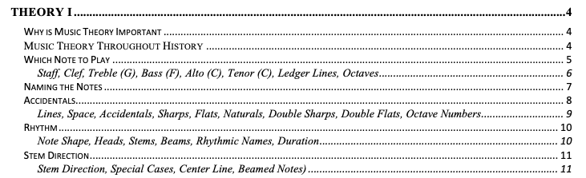
Music Theory:
A Thorough and Fast-Paced Review
Of Theory I, II, III, and IV

Slide 13
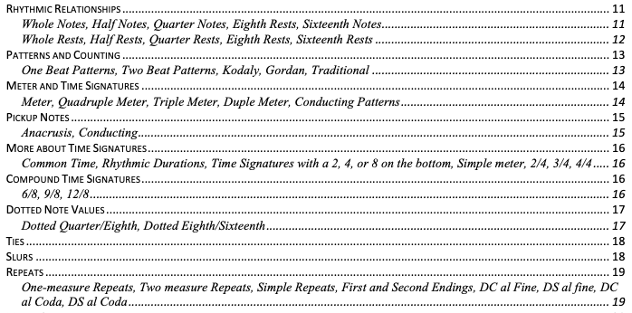
Music Theory:
A Thorough and Fast-Paced Review
Of Theory I, II, III, and IV

Slide 14
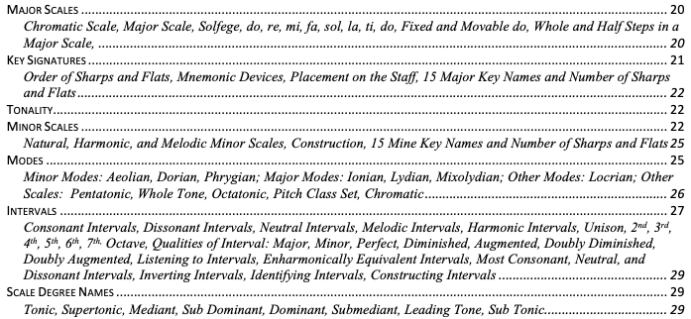
Music Theory:
A Thorough and Fast-Paced Review
Of Theory I, II, III, and IV

Slide 15
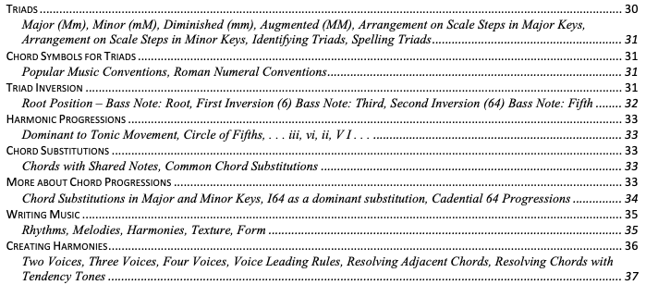
Music Theory:
A Thorough and Fast-Paced Review
Of Theory I, II, III, and IV

Slide 16
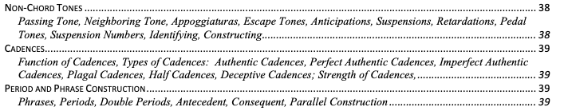
Music Theory:
A Thorough and Fast-Paced Review
Of Theory I, II, III, and IV

Slide 17
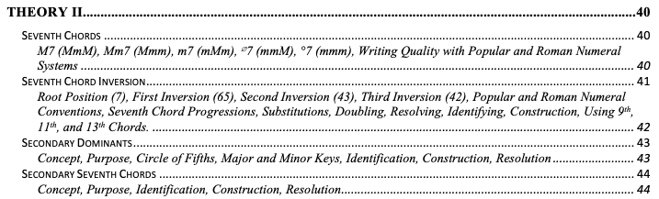
Music Theory:
A Thorough and Fast-Paced Review
Of Theory I, II, III, and IV

Slide 18
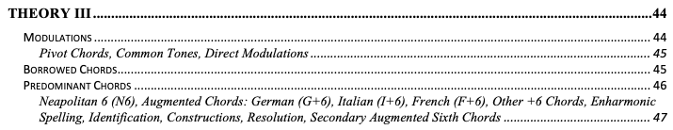
Music Theory:
A Thorough and Fast-Paced Review
Of Theory I, II, III, and IV

Slide 19
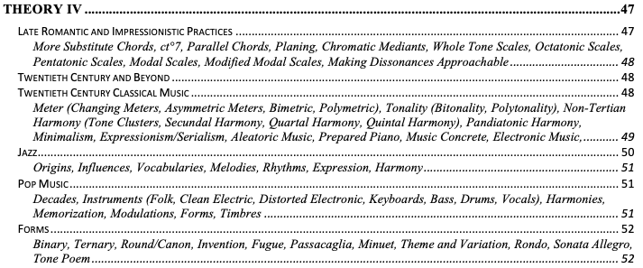
Music Theory:
A Thorough and Fast-Paced Review
Of Theory I, II, III, and IV

Slide 20
Music Theory:
A Thorough and Fast-Paced Review
Of Theory I, II, III, and IV
The project includes
A .doc or .pdf textbook (https://musictheory.tech).
More than 30 “Music-Minute” videos describing various concepts.
Interactive assessments for materials in the book.

Slide 21
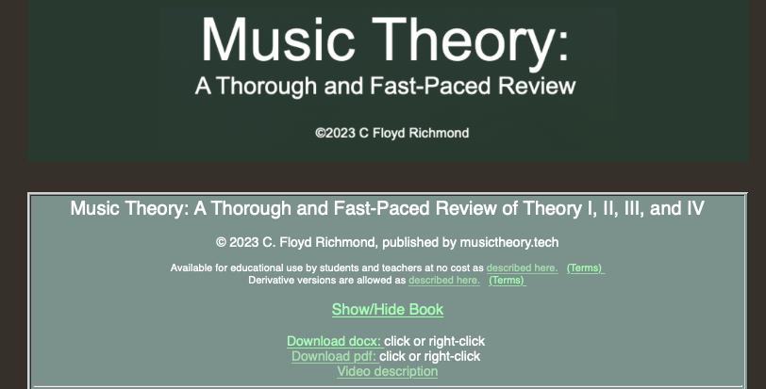
Music Theory:
A Thorough and Fast-Paced Review
Of Theory I, II, III, and IV
The project includes a .doc or .pdf textbook.
https://musictheory.tech

Slide 22
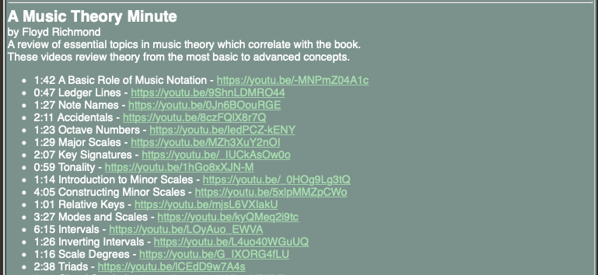
Music Theory:
A Thorough and Fast-Paced Review
Of Theory I, II, III, and IV
The project includes more than 30 “Music-Minute” videos

Slide 23
Music Theory:
A Thorough and Fast-Paced Review
Of Theory I, II, III, and IV
The project includes more than 30 “Music-Minute” videos
1:42 A Basic Role of Music Notation - https://youtu.be/-MNPmZ04A1c
0:47 Ledger Lines - https://youtu.be/9ShnLDMRO44
1:27 Note Names - https://youtu.be/0Jn6BOouRGE
2:11 Accidentals - https://youtu.be/8czFQlX8r7Q
1:23 Octave Numbers - https://youtu.be/IedPCZ-kENY
1:29 Major Scales - https://youtu.be/MZh3XuY2nOI
2:07 Key Signatures - https://youtu.be/_IUCkAsOw0o
0:59 Tonality - https://youtu.be/1hGo8xXJN-M
1:14 Introduction to Minor Scales - https://youtu.be/_0HOg9Lg3tQ
4:05 Constructing Minor Scales - https://youtu.be/5xlpMMZpCWo
1:01 Relative Keys - https://youtu.be/mjsL6VXIakU
3:27 Modes and Scales - https://youtu.be/kyQMeq2i9tc
6:15 Intervals - https://youtu.be/LOyAuo_EWVA
1:26 Inverting Intervals - https://youtu.be/L4uo40WGuUQ

Slide 24
Music Theory:
A Thorough and Fast-Paced Review
Of Theory I, II, III, and IV
The project includes more than 30 “Music-Minute” videos
1:16 Scale Degrees - https://youtu.be/G_IXORG4fLU
2:38 Triads - https://youtu.be/lCEdD9w7A4s
2:08 Chord Symbols - https://youtu.be/6VbycYPiiDE
3:28 Triad Inversions - https://youtu.be/awKbEh3HWbU
1:29 Chord Progressions - https://youtu.be/bkgaSMS7J20
0:59 Chord Substitutions - https://youtu.be/MSV4B8jjCVQ
1:34 More Chord Progressions - https://youtu.be/0Of2aPthHe0
2:35 Writing Music - https://youtu.be/WPc-dwnN9rM
3:00 Two, three, and four voice harmony - https://youtu.be/BPxU7irxXiA
2:04 Voice Leading - https://youtu.be/-SJrq9Kppns
1:56 Resolving Chords - https://youtu.be/6aMlbPo72bQ
1:49 Non-Chord Tones - https://youtu.be/FdQAjzlWvuI
2:24 Cadences - https://youtu.be/zjSr4hHKlwk
1:23 Phrases and Periods - https://youtu.be/DNOo1zr_Kg4

Slide 25
Music Theory:
A Thorough and Fast-Paced Review
Of Theory I, II, III, and IV
The project includes more than 30 “Music-Minute” videos
2:17 Seventh Chords - https://youtu.be/5WGoLrhAZGg
3:46 Seventh Chord Inversions - https://youtu.be/YG-lWE1a_oY
3:20 Secondary Dominants - https://youtu.be/AunDTXoNjjI
3:38 Modulations - https://youtu.be/xTckcIeXZvw
2:06 Borrowed Chords - https://youtu.be/kMHkTfqrFto
3:58 Predominant Chords - https://youtu.be/tzB6eEfACz0
3:44 Late Romantic And Impressionistic Harmony - https://youtu.be/b0Lx_mNdXRc
3:54 Music History - https://youtu.be/J3oeWplcZI0
1:31 Instruments of the Orchestra - https://youtu.be/QOH0olQUy54

Slide 26
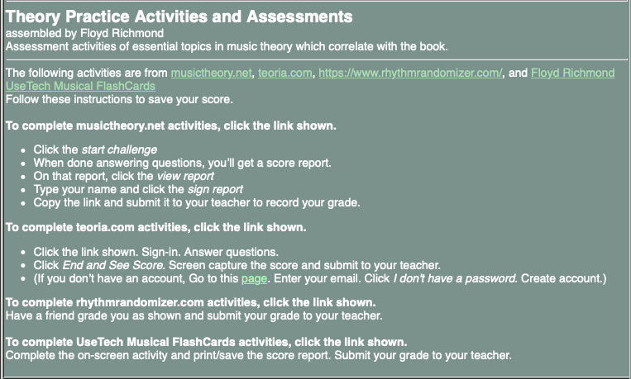
Music Theory:
A Thorough and Fast-Paced Review
Of Theory I, II, III, and IV
The project includes interactive assessments for materials in the book.

Slide 27
Music Theory:
A Thorough and Fast-Paced Review
Of Theory I, II, III, and IV
Notes, Staves, Clefs
https://musictheory.net
dentify 10 notes treble clef.
Identify 10 notes bass clef.
Identify 10 notes alto clef.
Identify 10 notes tenor clef.
Identify 10 notes keyboard.
Identify 20 notes treble, bass, alto and tenor clefs with ledger lines.
Place 10 notes treble clef staff.
Place 10 notes bass clef staff.
Place 10 notes alto clef staff.
Place 10 notes tenor clef staff.
Place 10 notes keyboard.
Place 20 notes treble, bass, alto and tenor clefs with ledger lines
Notes, Staves, Clefs
https://www.floydrichmond.com/usetech/musicalflashcards/
Identify 13 notes treble clef.
Identify 13 notes bass clef.
Identify 13 notes alto clef.
Identify 13 notes tenor clef.

Slide 28
Music Theory:
A Thorough and Fast-Paced Review
Of Theory I, II, III, and IV
Rhythms
https://www.rhythmrandomizer.com/
Click the link below. Click New Rhythm. Click Start Playback. Clap the rhythm. Have a friend grade you: (1 error = A, 2 = B, 3 = C, etc.). If you do multiple problems, times that number of problems (example – do 5 problems A= 5 or less = 8, 10 or less = B, etc.) Submit your grade to your teacher. All problems have a 4 beat count-off.
Level 1 – 4/4 (Q, QR, EE, E.S) Q=96 (2 bars)
Level 2 – 4/4 (Add: SSSS, SSE, ESS, SES, TTT) Q=88 (2 bars)
Level 3 – 4/4 (Add: Dotted Note Combinations) Q = 88 (2 bars)
Level 4 – 4/4 (Add: Eight Rest Combinations and EQE) Q = 80 (2 bars)
Level 5 – 4/4 (Add: Quarter and eighth tuplets) Q = 80 (2 bars)
Level 6 – 4/4 (Most everything reasonable) Q = 80 (4 bars)
Level 7 – 6/8 (Basic 6/8 rhythms) Q = 88 (4 bars)
Level 8 – 6/8 (Add: SE combinations) Q = 72 (4 bars)
Level 9 – 6/8 (Add duplets and other SE combinations) Q = 72 (4 bars)
Level 10 – 6/8 (Most everything reasonable) Q = 72 (4 bars)

Slide 29
Music Theory:
A Thorough and Fast-Paced Review
Of Theory I, II, III, and IV
Key Signatures
musictheory.net
dentify 10 - major key signatures.
Identify 15 - number of sharps and flats - major.
Identify 10 – minor key signatures
Identify 15 – number of sharps and flats – minor
Identify 15 – major or minor key signatures
Identify 15 – number of sharps and flats – major or minor
Key Signatures
https://www.floydrichmond.com/usetech/musicalflashcards/
Identify 15 - major key signatures.
Identify 15 – minor key signatures
Identify 30 – major and minor key signatures
Key Signatures
teoria.com
Identify 15 major key signatures
Identify 15 major and minor key signatures

Slide 30
Music Theory:
A Thorough and Fast-Paced Review
Of Theory I, II, III, and IV
Scales
musictheory.net
Identify 10 Mm scales.
Identify 10 modes
Listen and identify 10 Mm scales.
Listen and identify 10 modes.
Construct 10 Mm scales
Construct 10 modes.

Slide 31
Music Theory:
A Thorough and Fast-Paced Review
Of Theory I, II, III, and IV
Intervals
musictheory.net
(Intervals – No Quality)
Identify 15
Construct 10
Major and Perfect Intervals
Identify 15
Construct 10 Staff
Identify 10 Keyboard
Listen and identify 10 Staff
Maj, Min, Dim, Aug
Identify 15
Construct 10 Staff
Identify 10 Keyboard
Listen and identify 10 Staff

Slide 32
Music Theory:
A Thorough and Fast-Paced Review
Of Theory I, II, III, and IV
Chords
musictheory.net
Identify 10 Chords Mm°+
With inversions
Seventh Chords
musictheory.net
Identify 10 Seventh Chords
With inversions
Listen and Identify 10 Mm°+
With inversions
Listen and Identify 10,
With inversions
Only M7, Mm7, m7
Only ^{Æ}7, °7
Build 10 Chords Mm°+
With inversions
Build 10 Chords,
With inversions

Slide 33
Music Theory:
A Thorough and Fast-Paced Review
Of Theory I, II, III, and IV
Other OER Resources in Music:
https://oertx.highered.texas.gov/search?batch_size=100&sort_by=search&view_mode=summary&f.search=Music%20Theory
This search will find Music Theory and Music Appreciation and History resources. Results

Slide 34
open Education Resources
Dr. C. Floyd Richmond
Tarleton State University
crichmond@tarleton.edu
NYSSMA
Rochester, NY
1:15 December 2, 2023
http://floydrichmond.com/nyssma2023
http://musictheory.tech/
https://www.tarleton.edu/performingarts/music/

Slide 35
TI:ME Composition Festival
Deadline: Jan 15, 2024.
Late submissions will not be accepted

Slide 36
TI:ME Composition Festival
The contest is open to students in grades PK-12, and to those in college. Submissions will be judged by category and by grade group.
Grade Groups
Elementary (Grade 6 and below)
Middle School (Grades 7-8)
High School (Grades 9-12)
College – Undergraduate
College – Graduate

Slide 37
TI:ME Composition Festival
Students will submit a project conforming to one of the categories listed below.
Original Composition – DAW
Original Composition – Notation
Covers, Remixes & Loop-Based Projects
Multimedia
Applied Technology

Slide 38

TI:ME Composition Festival
Original Composition – DAW
Original compositions for any combination of electronic instruments and/or other instrument(s)/voices, and produced using digital audio workstation software (DAW). Compositions should demonstrate skill in production and using DAW software. Projects incorporating use of prerecorded loops will not be considered in this category. Entries will be submitted as mp3 audio files (160 kbps minimum)

Slide 39
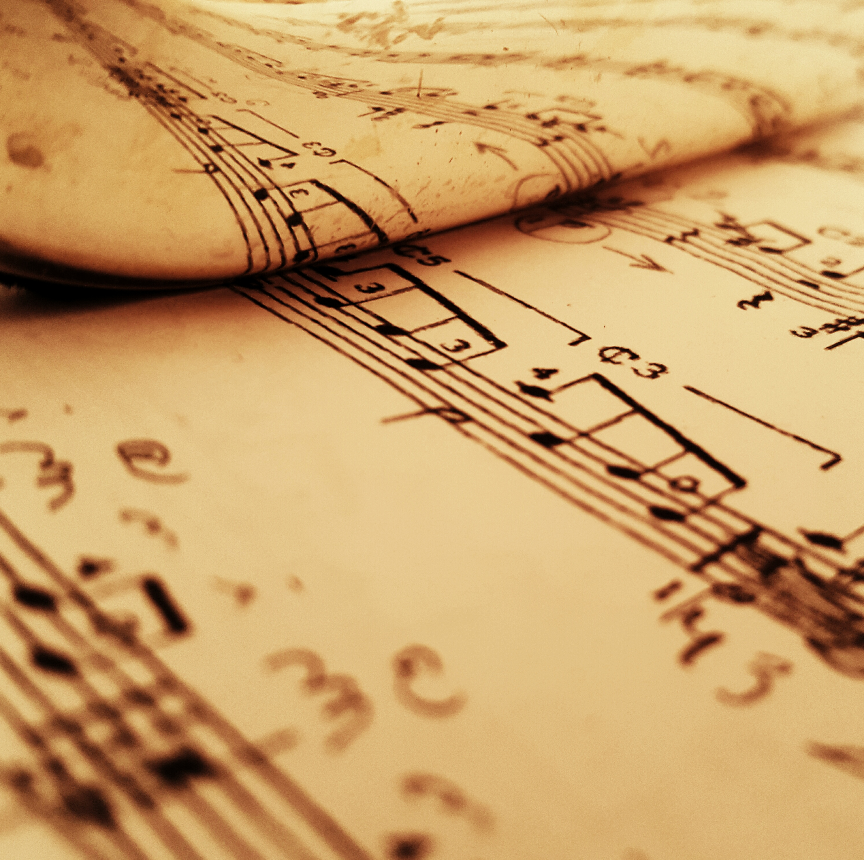
TI:ME Composition Festival
Original Composition – Notation
Original compositions for any combination of electronic instruments and/or other instrument(s)/voices, and produced using notation software (DAW). Compositions should should demonstrate skill using notation software. Submissions should include a score (PDF) and audio realization (mp3, 128 kbps minimum)

Slide 40

TI:ME Composition Festival
Covers, Remixes & Loop-Based Projects
Arrangements/recordings of pre-existing songs, song samples and projects incorporating a combination of original material and pre-recorded loops. Projects should demonstrate originality and creative use of technology and skills in mixing and production. Entries will be submitted as mp3 audio files (160 kbps minimum)

Slide 41

TI:ME Composition Festival
Multimedia
Works demonstrating the convergence of music with more than one discipline, which may include art/photography, video, broadcast journalism, digital storytelling or other media. Works need not be original compositions, but should reflect the creative use of technology and demonstrate skill in integrating media. Entries will be submitted as a video demonstration (mp4).

Slide 42

TI:ME Composition Festival
Applied Technology
Distinctive projects that utilize technology for a specific purpose. Works may include the creation of new electronic musical instruments, interactive music systems, software projects to aid in composition, performance, and music instruction, and more. Entries will be submitted as a video demonstration (mp4).

Slide 43
TI:ME Composition Festival
Recent Winners
and
Example Projects

Slide 44
TI:ME Composition Festival - Winners
Original Composition – Notation
Middle School, Forbidden Love by Callan Fox, The Hockaday School, TX, student of Yung-Fang Ludford
High School, TIE: Bridget by Davis Shanks, Katy ISD, TX, student of Matthew Porter
High School, TIE: Alla Luna by Makenna Harding-Davis, Natomas Charter School, CA, student of Matthew Spiva
College: Undergraduate, Covid Suite for Five Wind Instruments by Daniel Gowans, Cantonment, FL, student of Mr. Nick Kozar
College: Graduate, Walls of Jericho by Samuel Jenkins, Houghton College, NY, student of Carrie Magin

Slide 45
TI:ME Composition Festival - Winners
Original Composition – DAW
Elementary, Oceans by James Ransom, Bloomington Junior High School, IL, student of Michele Carnahan
Middle School, Under Harmonious Skies by Kevin Li, Kealing Middle School, TX, student of Eric Lyday
High School, TIE: Farouk Rises by Jasur Cosby, Arundel High School, MD, student of Bob Abbott
High School, TIE: Resfeber by Benjamin Lowery, Benbrook Middle High School, TX, student of Deborah O’Brien,
College: Undergraduate, The Life of a Loved One byWill Eby, Houghton College, NY, student of Carrie Magin
College: Graduate, Phlow by Ken Sarmiento, Tarleton State University, TX, student of Floyd Richmond

Slide 46
TI:ME Composition Festival - Winners
Covers, Remixes & Loop-Based Projects
Elementary: The Cross by Rylee Hadley, Brock Intermediate School, TX, student of Kelly Clements
High School, Closer by Henry Tobias, McKinley High School, OH, student of Brian Laakso
College: Undergraduate, School Days by Timothy Knighten, Riverside City College Riverside CA, student of Jennifer Amaya

Slide 47
TI:ME Composition Festival - Winners
Multimedia
Elementary, Two Worlds by Connie Zhao, The Hockaday School, TX, student of Yung-Fang Ludford
High School, Transformation by Karie Rodriguez, Lee Academy, TX, student of Ms. Delma Denise Ramos
College: Undergraduate, Stranded by Jordyn Ramos, Tarleton State University, TX, student of Floyd Richmond

Slide 48
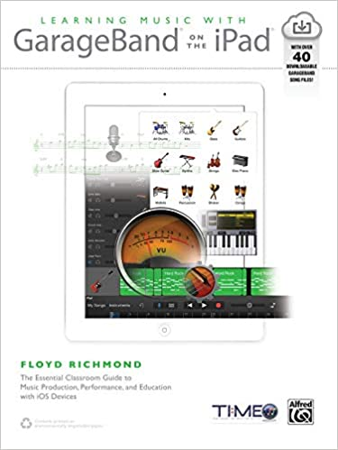
Learning Music With GarageBand on the iPad
Over Forty Lesson Plans with Resources
Detailed Pictures

Slide 49
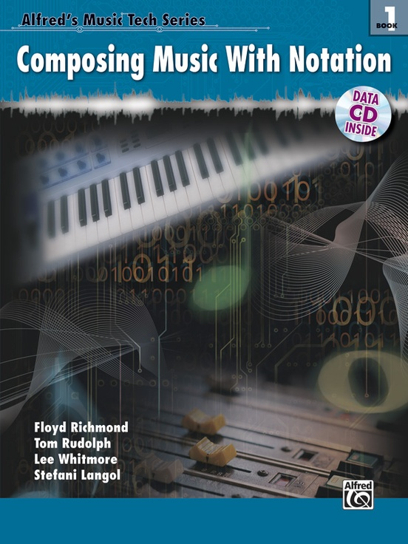
Composing Music With Notation
Chapter 1: Using Notation Software
Chapter 2: Copy and Paste Building Blocks
Chapter 3: Sixteen Bar Songs
Chapter 4: Jazz
Chapter 5: Theme and Variation

Slide 50
open Education Resources
Dr. C. Floyd Richmond
Tarleton State University
crichmond@tarleton.edu
NYSSMA
Rochester, NY
1:15 December 2, 2023
http://floydrichmond.com/nyssma2023
http://musictheory.tech/
https://www.tarleton.edu/performingarts/music/

