Slide 1
TI:ME Composition Festival
Dr. C. Floyd Richmond
Tarleton State University
crichmond@tarleton.edu
NYSSMA
Rochester, NY
1:15 December 1, 2023
http://floydrichmond.com/nyssma2023
https://www.tarleton.edu/finearts/music/

Slide 2
Tarleton State University
Texas A&M University
System Founding Member

Slide 3
Tarleton State University
Dr. James Hurley, President
John Tarleton, Founder

Slide 4
Tarleton State University
Concert Ensembles

Slide 5
Tarleton State University
Bachelor of Arts
  General Music
  Music Business
Bachelor of Music
  Music Education
  Performance
  Jazz
  Musical Theater
Masters of Music Education

Slide 6
Tarleton State University
Masters of Music Education
  Entirely online
  Work at your Convenience
  8-week Classes
  Starting in January
    Technology in the Music Classroom
    Research

Slide 7
TI:ME Composition Festival
Dr. C. Floyd Richmond
Tarleton State University
crichmond@tarleton.edu
NYSSMA
Rochester, NY
2:15 December 1, 2023
http://floydrichmond.com/nyssma2023
https://www.tarleton.edu/finearts/music/

Slide 8
Unlocking Creativity
Creativity is a highly desirable educational outcome
Music and the arts give students more opportunities to be creative than virtually any other discipline.
This session will feature creative activities for students on all levels including notation and production lessons suitable for elementary and secondary students in general music and ensembles.

Slide 9
Creativity
The goal of education is to ensure that individuals and societies survive and thrive. This is where the arts and humanities excel. They nourish the soul. They feed the imagination and foster creativity. A complete education must include beautiful music, songs of love and inspiration, stories of determination and perseverance, the ability to discriminate between good and evil, and the courage to act in the appropriate moment. A thriving society requires a generation of dreamers. When found in the population in good measure, all will prosper.
Floyd Richmond

Slide 10
Creativity
  I can’t understand why people are frightened of new ideas. I’m frightened of the old ones.
  John Cage

Slide 11
TI:ME Composition Festival
This is a festival, not a contest.
Every student gets feedback on their entries.

Slide 12
TI:ME Composition Festival
TI:ME is pleased to announce the 2023-2024 Music Technology Composition Contest. The contest is open to music students of all ages.

Slide 13
TI:ME Composition Festival
Prizes will be awarded for the top entries in each of five categories and five age groups with one Grand Prize to be awarded to the overall best entry. There is no entry fee, but students or their teachers must be a TI:ME member.

Slide 14
TI:ME Composition Festival
Deadline: Jan 15, 2024.
Late submissions will not be accepted

Slide 15
TI:ME Composition Festival
The contest is open to students in grades PK-12, and to those in college. Submissions will be judged by category and by grade group.
Grade Groups
Elementary (Grade 6 and below)
Middle School (Grades 7-8)
High School (Grades 9-12)
College – Undergraduate
College – Graduate

Slide 16
TI:ME Composition Festival
Students will submit a project conforming to one of the categories listed below.
Original Composition – DAW
Original Composition – Notation
Covers, Remixes & Loop-Based Projects
Multimedia
Applied Technology

Slide 17
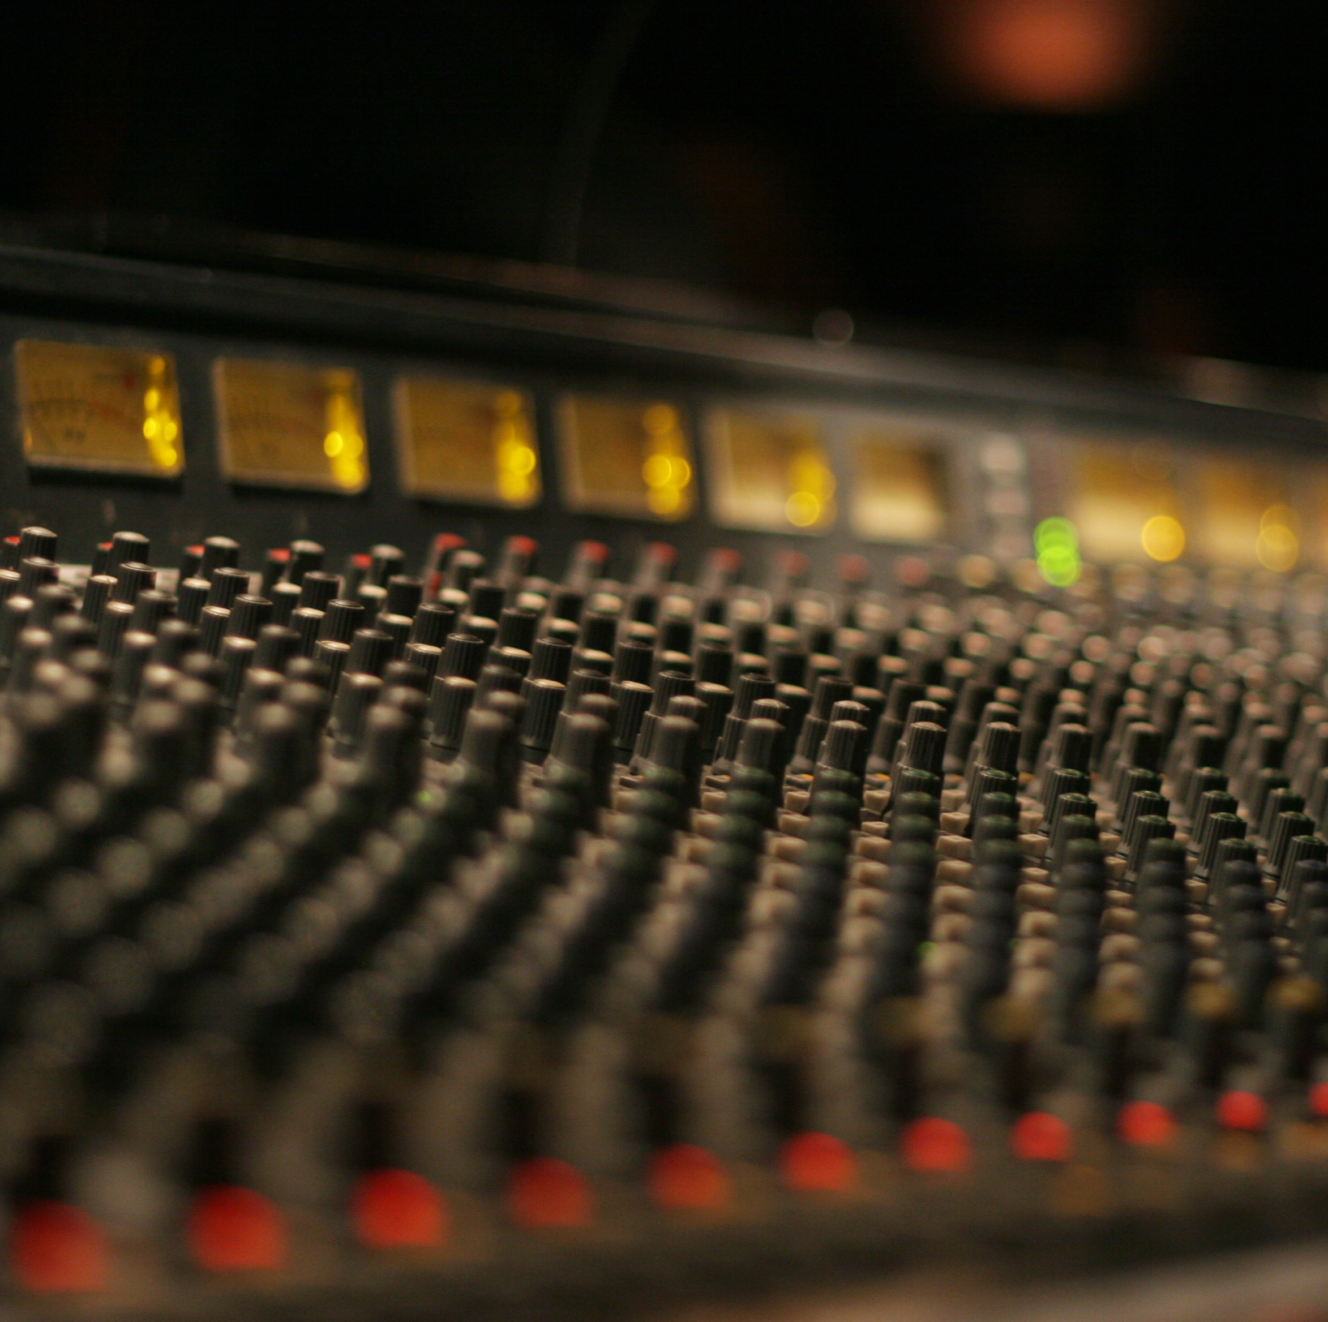
TI:ME Composition Festival
Original Composition – DAW
Original compositions for any combination of electronic instruments and/or other instrument(s)/voices, and produced using digital audio workstation software (DAW). Compositions should demonstrate skill in production and using DAW software. Projects incorporating use of prerecorded loops will not be considered in this category. Entries will be submitted as mp3 audio files (160 kbps minimum)

Slide 18

TI:ME Composition Festival
Original Composition – Notation
Original compositions for any combination of electronic instruments and/or other instrument(s)/voices, and produced using notation software (DAW). Compositions should should demonstrate skill using notation software. Submissions should include a score (PDF) and audio realization (mp3, 128 kbps minimum)

Slide 19

TI:ME Composition Festival
Covers, Remixes & Loop-Based Projects
Arrangements/recordings of pre-existing songs, song samples and projects incorporating a combination of original material and pre-recorded loops. Projects should demonstrate originality and creative use of technology and skills in mixing and production. Entries will be submitted as mp3 audio files (160 kbps minimum)

Slide 20

TI:ME Composition Festival
Multimedia
Works demonstrating the convergence of music with more than one discipline, which may include art/photography, video, broadcast journalism, digital storytelling or other media. Works need not be original compositions, but should reflect the creative use of technology and demonstrate skill in integrating media. Entries will be submitted as a video demonstration (mp4).

Slide 21

TI:ME Composition Festival
Applied Technology
Distinctive projects that utilize technology for a specific purpose. Works may include the creation of new electronic musical instruments, interactive music systems, software projects to aid in composition, performance, and music instruction, and more. Entries will be submitted as a video demonstration (mp4).

Slide 22
TI:ME Composition Festival
In addition, each entry must include a written description of your creative process. How did you start creating the project (what was your influence or impetus?) What process did you go through to create the work? What did you learn during the process of creating your project? (maximum 500 words)

Slide 23
TI:ME Composition Festival
Evaluation
The contests are judged by experts in music technology and composition. Entries will be evaluated on musical content, technical proficiency, creativity, and reflection.
All decisions by TI:ME are final. Judges will select a winner for each category and age group, as well as one overall winner. Additional recognition may be given where appropriate.

Slide 24
TI:ME Composition Festival
To Submit your Project
There are no fees for entering the composition contest. In order to enter, however, either the student or the student’s teacher must be a member of TI:ME. Visit http://www.ti-me.org to join.

Slide 25
TI:ME Composition Festival
Complete the online form at ti-me.org. You will need to provide shared links to your project files and description.
Upload your files to a cloud-based storage site such as Google Drive or Dropbox.
Right click on each file and get the Link. Sharing must be turned on.
Files without proper permissions will be disqualified.
Copy and paste the link into a different browser to test it. If it works, submit that link to TI:ME.

Slide 26
TI:ME Composition Festival
Recent Winners
and
Example Projects

Slide 27
TI:ME Composition Festival - Winners
Original Composition – Notation
Middle School, Forbidden Love by Callan Fox, The Hockaday School, TX, student of Yung-Fang Ludford
High School, TIE: Bridget by Davis Shanks, Katy ISD, TX, student of Matthew Porter
High School, TIE: Alla Luna by Makenna Harding-Davis, Natomas Charter School, CA, student of Matthew Spiva
College: Undergraduate, Covid Suite for Five Wind Instruments by Daniel Gowans, Cantonment, FL, student of Mr. Nick Kozar
College: Graduate, Walls of Jericho by Samuel Jenkins, Houghton College, NY, student of Carrie Magin

Slide 28
TI:ME Composition Festival - Winners
Original Composition – DAW
Elementary, Oceans by James Ransom, Bloomington Junior High School, IL, student of Michele Carnahan
Middle School, Under Harmonious Skies by Kevin Li, Kealing Middle School, TX, student of Eric Lyday
High School, TIE: Farouk Rises by Jasur Cosby, Arundel High School, MD, student of Bob Abbott
High School, TIE: Resfeber by Benjamin Lowery, Benbrook Middle High School, TX, student of Deborah O’Brien,
College: Undergraduate, The Life of a Loved One byWill Eby, Houghton College, NY, student of Carrie Magin
College: Graduate, Phlow by Ken Sarmiento, Tarleton State University, TX, student of Floyd Richmond

Slide 29
TI:ME Composition Festival - Winners
Covers, Remixes & Loop-Based Projects
Elementary: The Cross by Rylee Hadley, Brock Intermediate School, TX, student of Kelly Clements
High School, Closer by Henry Tobias, McKinley High School, OH, student of Brian Laakso
College: Undergraduate, School Days by Timothy Knighten, Riverside City College Riverside CA, student of Jennifer Amaya

Slide 30
TI:ME Composition Festival - Winners
Multimedia
Elementary, Two Worlds by Connie Zhao, The Hockaday School, TX, student of Yung-Fang Ludford
High School, Transformation by Karie Rodriguez, Lee Academy, TX, student of Ms. Delma Denise Ramos
College: Undergraduate, Stranded by Jordyn Ramos, Tarleton State University, TX, student of Floyd Richmond

Slide 31
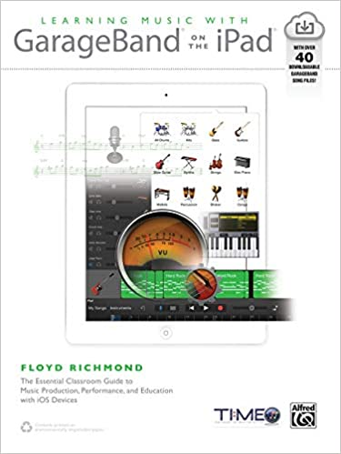
Learning Music With GarageBand on the iPad
Over Forty Lesson Plans with Resources
Detailed Pictures

Slide 32
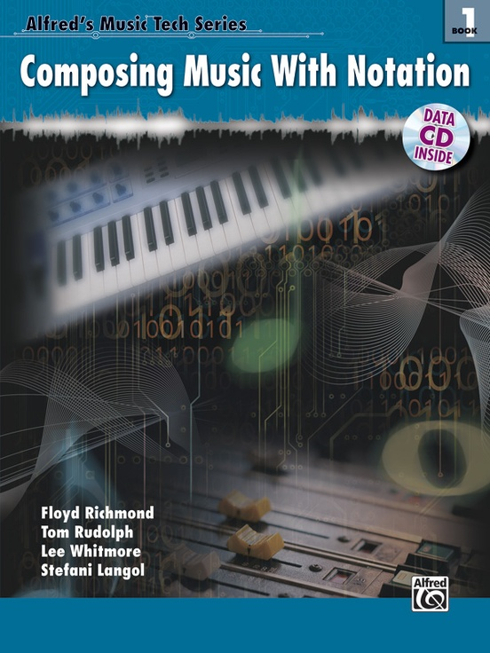
Composing Music With Notation
Chapter 1: Using Notation Software
Chapter 2: Copy and Paste Building Blocks
Chapter 3: Sixteen Bar Songs
Chapter 4: Jazz
Chapter 5: Theme and Variation

Slide 33
TI:ME Composition Festival
Dr. C. Floyd Richmond
Tarleton State University
crichmond@tarleton.edu
NYSSMA
Rochester, NY
2:15 December 1, 2023
http://floydrichmond.com/nyssma2023
https://www.tarleton.edu/finearts/music/

