Slide 1
Unlocking Creativity with Technology
Dr. C. Floyd Richmond
Tarleton State University
crichmond@tarleton.edu
Ohio Music Educators Conference
Cleveland, Ohio
11:00pm, February 5, 2022
https://floydrichmond.com/omea2022
https://www.tarleton.edu/finearts/music/

Slide 2
Tarleton State University
Texas A&M University
System Founding Member

Slide 3
Tarleton State University
Dr. James Hurley, President
John Tarleton, Founder

Slide 4
Tarleton State University
Concert Ensembles

Slide 5
Tarleton State University
Bachelor of Arts
  General Music
  Music Business
  Jazz
  Musical Theater
Bachelor of Music
  Music Education
  Performance
Masters of Music Education

Slide 6
Tarleton State University
Masters of Music Education
  Entirely online
  Work at your Convenience
  8-week Classes
  Starting in March
    Technology in the Music Classroom
    Research

Slide 7
Unlocking Creativity with Technology
Dr. C. Floyd Richmond
Tarleton State University
crichmond@tarleton.edu
Ohio Music Educators Conference
Cleveland, Ohio
11:00pm, February 5, 2022
https://floydrichmond.com/omea2022
https://www.tarleton.edu/finearts/music/

Slide 8
Unlocking Creativity
Creativity is a highly desirable educational outcome
Music and the arts give students more opportunities to be creative than virtually any other discipline.
This session will feature creative activities for students on all levels including notation and production lessons suitable for elementary and secondary students in general music and ensembles.

Slide 9
Creativity
  I can’t understand why people are frightened of new ideas. I’m frightened of the old ones.
  John Cage

Slide 10
Creativity
The goal of education is to ensure that individuals and societies survive and thrive. This is where the arts and humanities excel. They nourish the soul. They feed the imagination and foster creativity. A complete education must include beautiful music, songs of love and inspiration, stories of determination and perseverance, the ability to discriminate between good and evil, and the courage to act in the appropriate moment. A thriving society requires a generation of dreamers. When found in the population in good measure, all will prosper.
Floyd Richmond

Slide 11
NAfME Standards 2014
Three Artistic Processes
  Creating
  Performing
  Responding
  (Connecting)

Slide 12
Carl Orff
There are four stages in developing creativity:
  Imitation
  Exploration
  Improvisation
  Composition

Slide 13
Imitation
Open these rhythms:
https://www.noteflight.com/scores/view/aed9b4245b75dae8b29b284c5feddb1f9c9725bd
Click on the first note, or a note anywhere in the exercises.
Press play.
Clap along.
Repeat until you complete 8 measures without a mistake.
Mark your progress.

Slide 14
Tips for Fostering Creativity
  Require students to create
  Limit their choices in early efforts so they can achieve success.
  Require them to reflect on what they have done and how it may be improved.
  Require to them to revise and improve their efforts.

Slide 15
Creative Notation Activities
Give s. a piece, modify its scale and change the mode.
Give s. melodic fragments and ask them to assemble a song.
Give s. a rhythm and ask them to change note to match a harmony and appropriate scale.
Give s. an accompaniment and ask them to compose a melody.
Give s. a melody and have them add block chords to harmonize it.
Give s. a melody and have them harmonize it with an Alberti bass.

Slide 16
Creative Notation Activities
Give s. a melody and have them harmonize it with creative accompaniment patterns that can be played by humans.
Require s. to compose a binary song (verse/chorus).
Given a verse and chorus song, have s. compose a development section.
Given music in various styles, have s. compose different songs in the same style.
Have s. compose a round, and similar pieces in an imitative style.
Give s. a song and ask them to modulate to a new key at the end of every phrase.

Slide 17
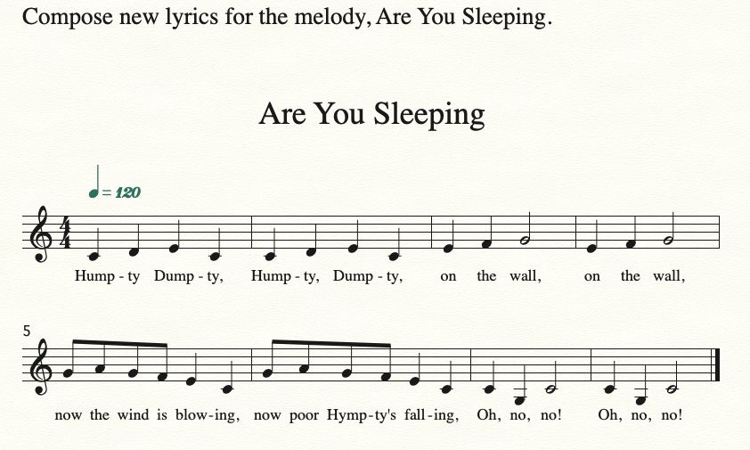
Given a piece, Compose Lyrics
See Alfred 01-01a
Open prepared file.
Finale
  Select lyric tool
  Click on first note
  Type new lyrics
Sibelius
  Select First note
  Type Command-L
  Type new lyrics

Slide 18
Given a piece, change Mode
Open Twinkle, Twinkle, Little Star: https://www.noteflight.com/scores/view/f431f89d69f488643b320927332200ee50231872
(1) Log into NoteFlight
(2) View this Score and Menu>Score>Save a Copy
(3) Select all (Command-A)
(4) Type up arrow key and listen to each:
(a) Once = Dorian, (b) Twice = Phrygian,
(c) Three times = Lydian, (d) Four times = Mixolydian
(e) Five times = Aeolian, (f) Six times = Locrian
Listen to Sym #94 and Mozart Twinkle, Minor Variation (m97)

Slide 19
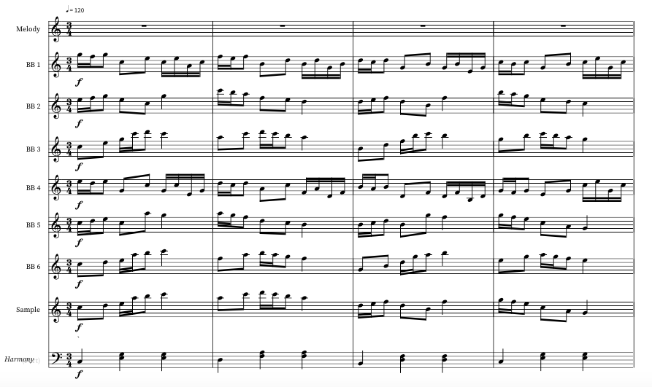
Creative Notation Activities
Give s. melodic fragments and ask them to assemble a song.
Minuet
https://www.noteflight.com/scores/view/44a8df9f34ef6f71caa8653199d55eb96770af7d

Slide 20
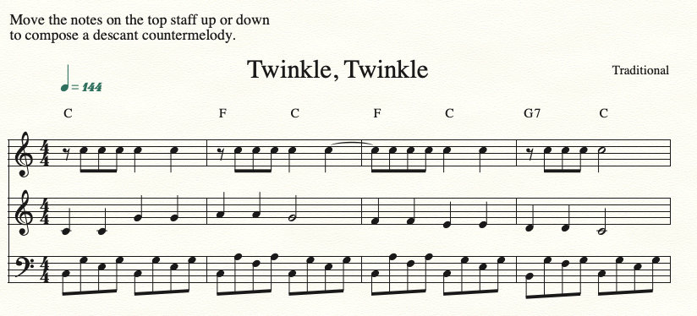
Creative Notation Activities
Give s. a rhythm and ask them to change note to match a harmony and appropriate scale.
Twinkle Variations – See Alfred 05-02

Slide 21
Creative Notation Activities
Give s. an accompaniment and ask them to compose a melody. (Blues)
https://www.noteflight.com/scores/view/d8ce53511720e703f615549ac00888626031bd2c
Save a copy of this song to your NoteFlight account.
Using notes from this blues scale (C, D, Eb, F, G, A Bb), replace the notes in the top system with your own.
Replace every original note with a different one of your choice!
Don't change rhythms or any accompaniment part.
Note: Some of the existing notes are not from the blues scale, but are ok. You can step outside the blues scale if it sounds good.
Listen and edit to make it sound good!
Print or share your work with your teacher

Slide 22
Creative Production Activities.
Give s. a loop-based tool such as GarageBand and ask them to assemble an introduction which starts simple and builds. (Demo Live Loops - GarageBand - iOS)
Teach s. to create a fade-out ending. (Select final phrase, choose Fade out from menu)
Have s. write an ending to a song which matches its style.
Give s. a loop-based tool such as GarageBand and ask them to assemble songs in specified styles. (Cuban Demo, Hip Hop Demo)

Slide 23
Creative Production Activities.
Have s. write and record rap over a rhythmic accompaniment. (Hip Hop Demo)
Have s. write and record lyrics to an existing melody and accompaniment. (Curtain Call)
Have s. write and record lyrics to a new melody over an existing accompaniment. (Curtain Call)
Have s. sample a sound (or collection of sounds) and compose a song using only that sound (or collection of sounds). (Learning Music with GarageBand for iOS – Palm Pipes)

Slide 24
Floyd Richmond
Dr. C. Floyd Richmond began teaching in 1980 as a high school band director and has taught all areas of PK-12 and higher education music. He holds a doctorate of arts in music from Ball State University. He is an active writer and clinician. He served as president of TI:ME from 2016-2018 and currently is the Area Coordinator for Music at Tarleton State University.

Slide 25

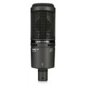
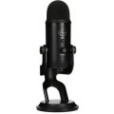
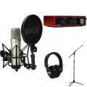
Making GarageBand More Powerful
  Add a professional microphone
  Add an audio interface
  Add a MIDI keyboard

Slide 26
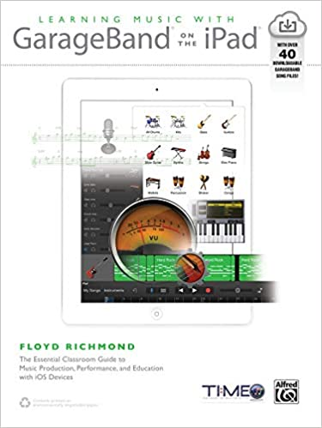
Learning Music With GarageBand on the iPad
Over Forty Lesson Plans with Resources
Detailed Pictures

Slide 27
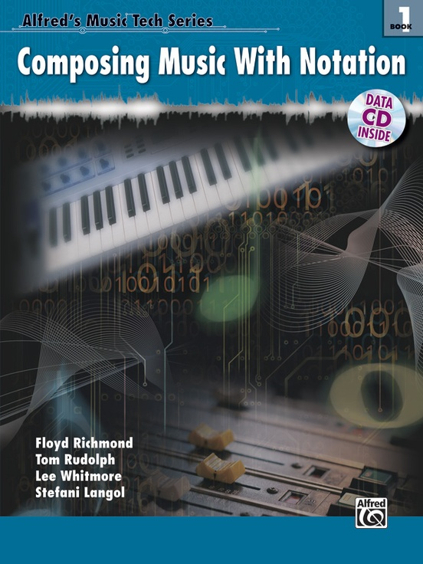
Composing Music With Notation
Chapter 1: Using Notation Software
Chapter 2: Copy and Paste Building Blocks
Chapter 3: Sixteen Bar Songs
Chapter 4: Jazz
Chapter 5: Theme and Variation

Slide 28
Unlocking Creativity with Technology
Dr. C. Floyd Richmond
Tarleton State University
CRichmond@Tarleton.edu
Ohio Music Educators Conference
Cleveland, Ohio
11:00am, February 5, 2022
https://floydrichmond.com/omea2022
https://www.tarleton.edu/finearts/music/

Slide 29
Unlocking Creativity with Technology
Dr. C. Floyd Richmond
Tarleton State University
crichmond@tarleton.edu
Ohio Music Educators Conference
Cleveland, Ohio
11:00pm, February 5, 2022
https://floydrichmond.com/omea2022
https://www.tarleton.edu/finearts/music/

