Slide 1
SmartMusic Workshop
Kevin Mead
ESS Clinician
Band director
churchville-chili senior high school
585-729-3051
kmead@rochester.rr.com

Slide 2
Creating a performance based APPR assessment?
After throwing out a written attempt at a pretest, we choose to utilize technology to get a better measure of student musical growth based on performance.
We created an assignment unit to measure several musical concepts and created a APPR class.
Every student (vocal and instrumental) took the test in school, by themselves, on the computer.
We added a human grade to SM’s assessment.
We included an essay on evaluating a performance and a composition question. (Common Core)
We used the exact same assignment and testing technique during the post test to compare results.

Slide 3
What are the advantages
Plenty of data available
You have a recording of each performance for future comparisons
Both the computer and the evaluator enters a grade for the performance (objective and subjective grading)
It is easy to have a different teacher grade the post-assessment
Use the data collected to improve instruction

Slide 4
Decide what you want to test
  Performance units
    Sight-Reading/Singing
    Rhythm
    Scales/Key Recognition
    Articulation/Diction
    Solfege
    Tone/Warm-Up
    Improvisation
  Written aspects
    Composition
    Written analysis
    Music symbol identification
  Any combination of these or others

Slide 5
Decide how you want to grade the assessment
Total performance or individual skills
  One overall grade for performance
  Grading individual skills
Number of examples you will use
  More information means more data
  More information means more time to grade
SmartMusic grade vs recording grade

Slide 6
How to get started
Write a clear, well defined rubric for consistent grading
Find examples in SmartMusic or write your own in Finale and create a smp file
Set up the example exactly the way you want the student to see it
  Count off
  Cursor
  Sight-reading
  Change assignment name
If you are using multiple examples, create a unit in SmartMusic

Slide 7
Assigning the test
Create a class
  The teacher that will be grading the test needs to be the one creating the class
  Select the quarter the test will be given
Assign the example/unit
  Don’t make assignment until the test is ready to be given
  Select the class created above and check:
  “Also assign to students who enroll later”

Slide 8
Administering the test
Make sure test computer is working well
Each student should have the same experience
Teacher observe the student enrolling in the class
Students should not hear or see the test examples prior to taking the test
Make sure students do a mic check before beginning the exam

Slide 9
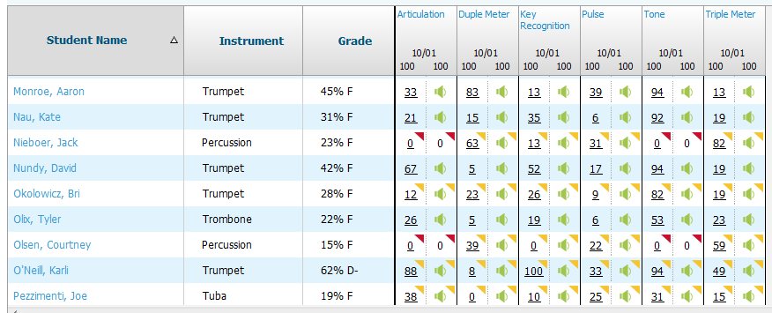
Sample test results
SmartMusic Gradebook view

Slide 10
Collecting the data
Use the export data feature of SmartMusic to create an excel spreadsheet with the SmartMusic assessment grade already in place
Add columns for the teacher rating(s)
Grade the recordings using the rubric
Add columns for final averages
Use mail merge to print out test results for each student

Slide 11
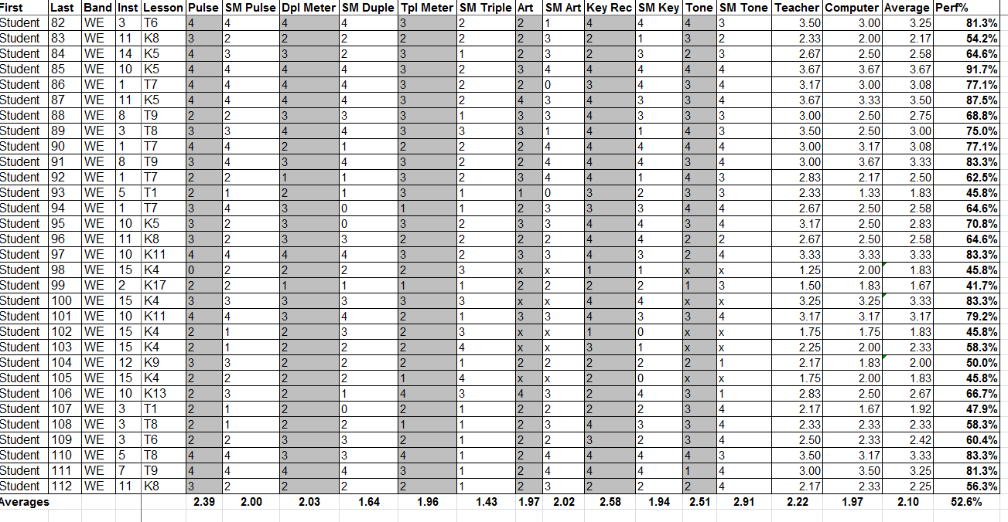
PRE-ASSESSMENT AVERAGES

Slide 12
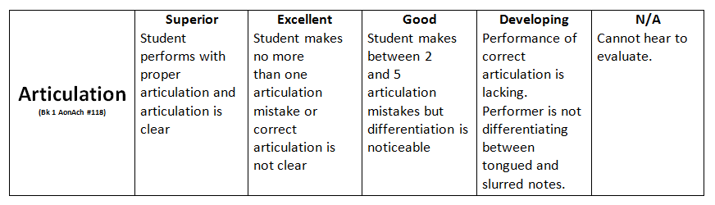

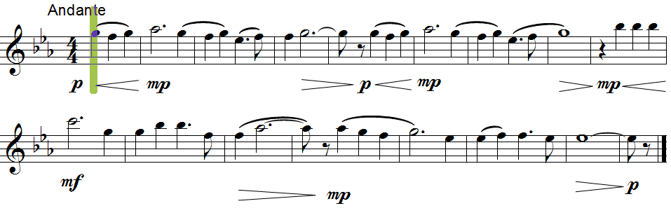

Slide 13
Writing the SLO
Common Growth Target
The goal of the music department is to increase the mean scores on the post assessment by 5 points over the pre-assessment mean.

Slide 14
Writing the SLO - Rationale
The same skills being tested on both the pre and post assessment have been taught to our current students since they began kindergarten. Students that scored an average of 50 points on the pre test have therefore taken 10 years to reach that level. With this information, we assume that a continued increase of five percent per year would be a reasonable goal until further testing patterns can be established.

Slide 15
Post Assessment
Every effort was made to match the pre-assessment logistics so we could compare apples to apples
The teacher that was going to be grading the post assessment set up the class
The same unit was assigned
The same rubrics were used for the human grading
Data comparisons were made on the spreadsheet

Slide 16
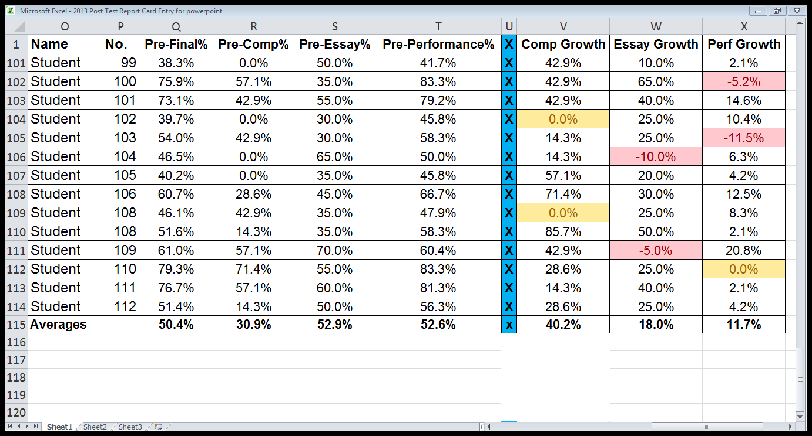
Final results and report

Slide 17
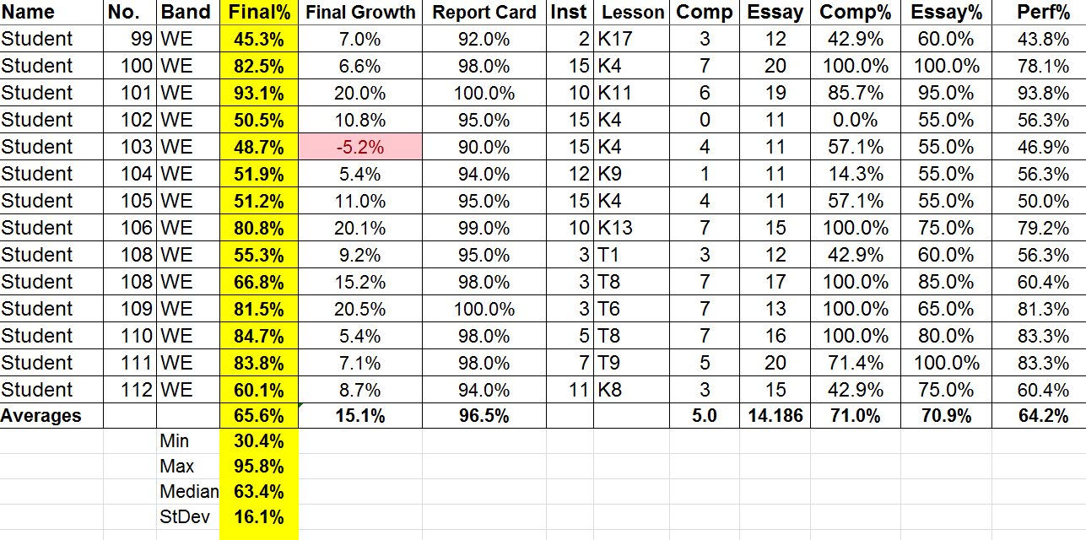
Final results and report

Slide 18
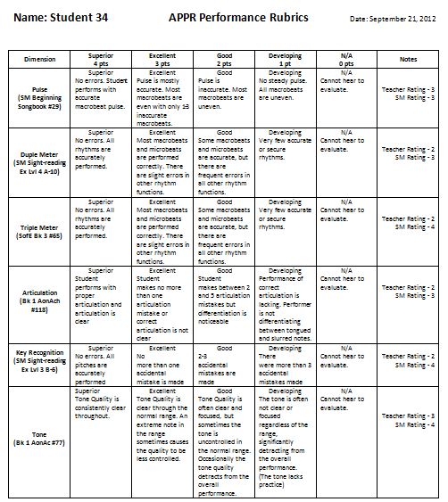

Slide 19
Using the information to improve instruction
Review the overall average data collected to identify strengths and weakness in your program
Make repertoire choices throughout the year to help improve student performance on those skills
Print out individual student scores to include in your grade book and/or lesson planning book for daily/weekly planning

Slide 20
PRE-ASSESSMENT AVERAGES

Slide 21
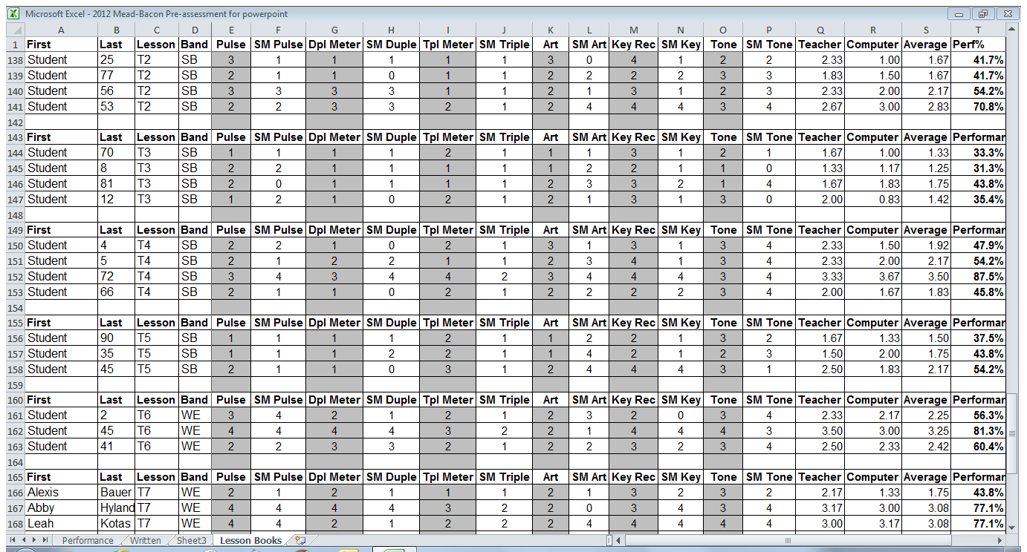
Information for Lesson Planning

Slide 22
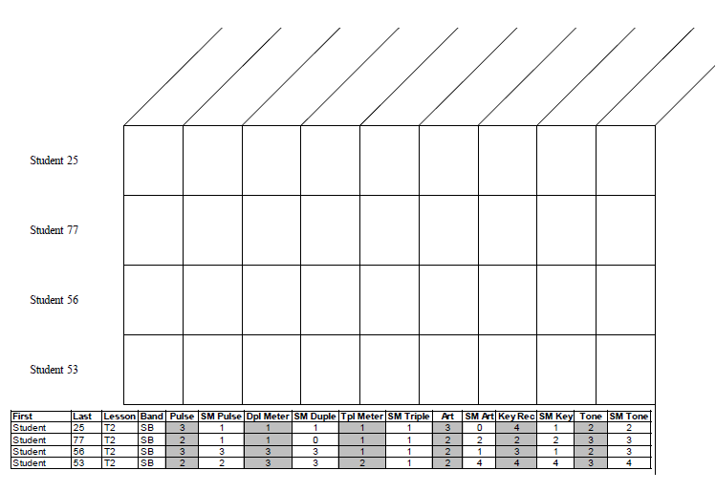
Grade book pages

Slide 23
Review
The process was time consuming but the information gathered was invaluable
Familiarizing students with the software by using it in lessons and home assignments improved SmartMusic scores automatically
We need to look at making the test questions grade specific so students don’t receive the same excerpt(s) from one year to another

