Slide 1
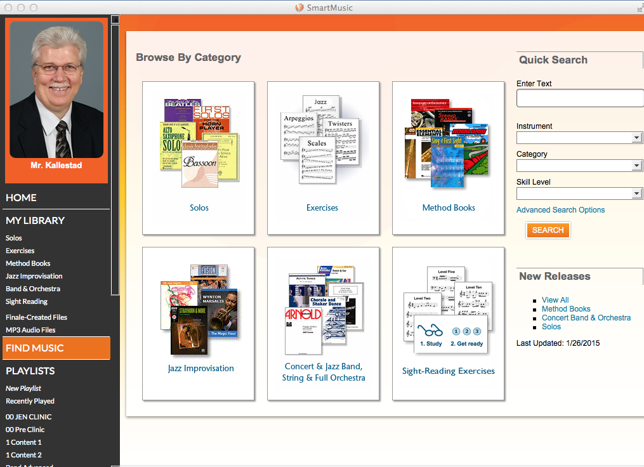
Notes:
SmartMusic has 6 main content area and you can add your own MP3 recordings and SmartMusic files that you create with Finale.

Slide 2
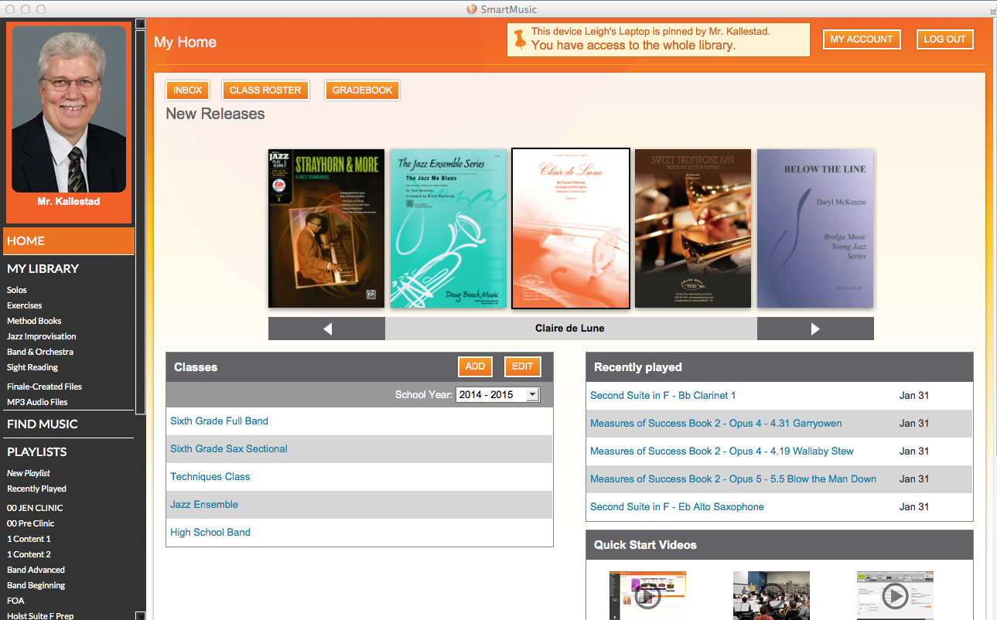
Notes:
With SmartMusic, you can create any number of classes.

Slide 3
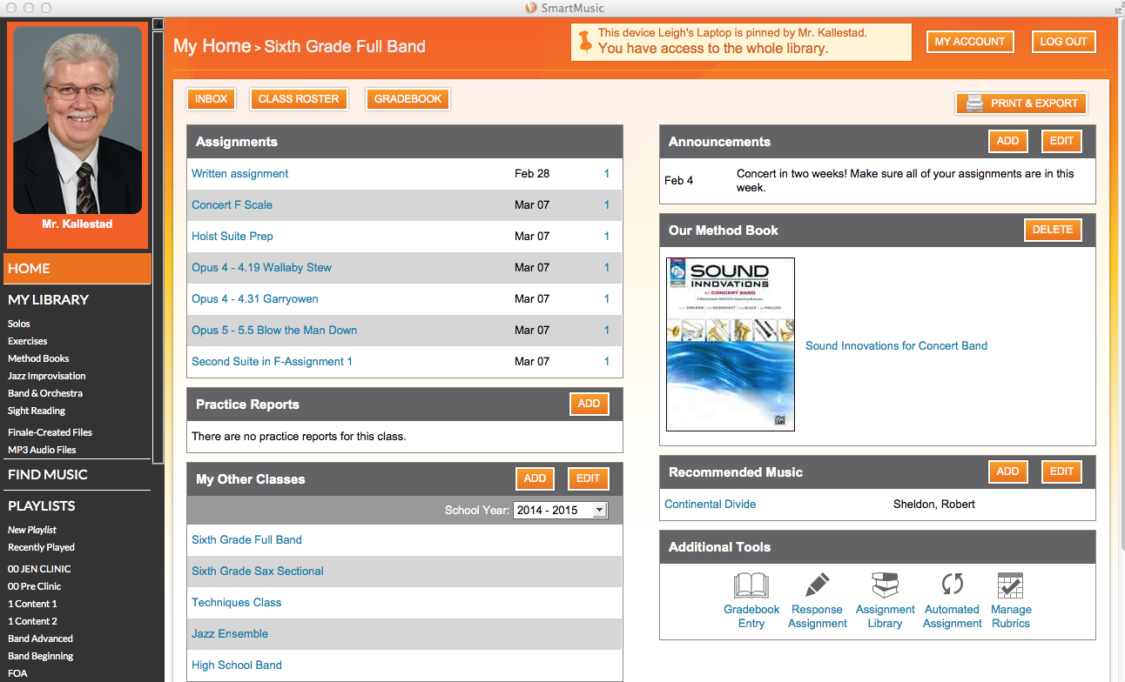
Notes:
Assignments can be scheduled to an entire class, small group of students or even an individual student. Many tea

Slide 4
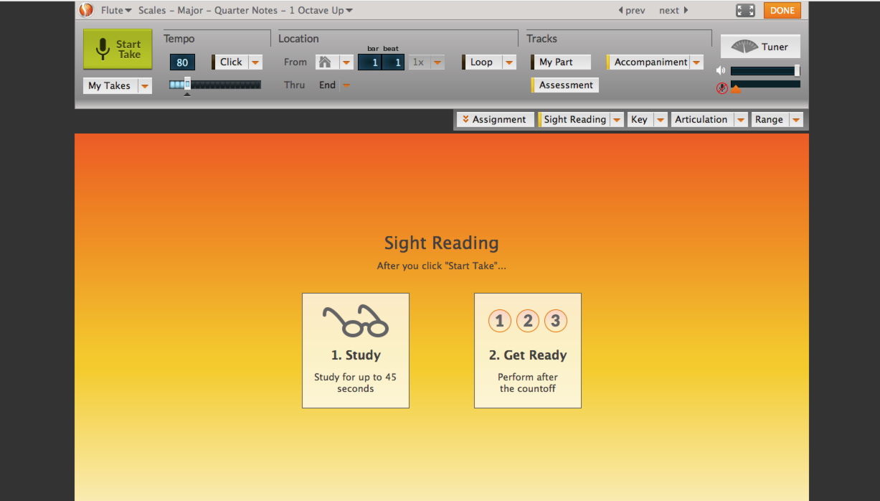
Notes:
Many teachers find that using the “Sight Reading” function in SmartMusic guarantees that all students have the exact same testing experience. The same number of seconds to prepare and only one time through the test.

Slide 5
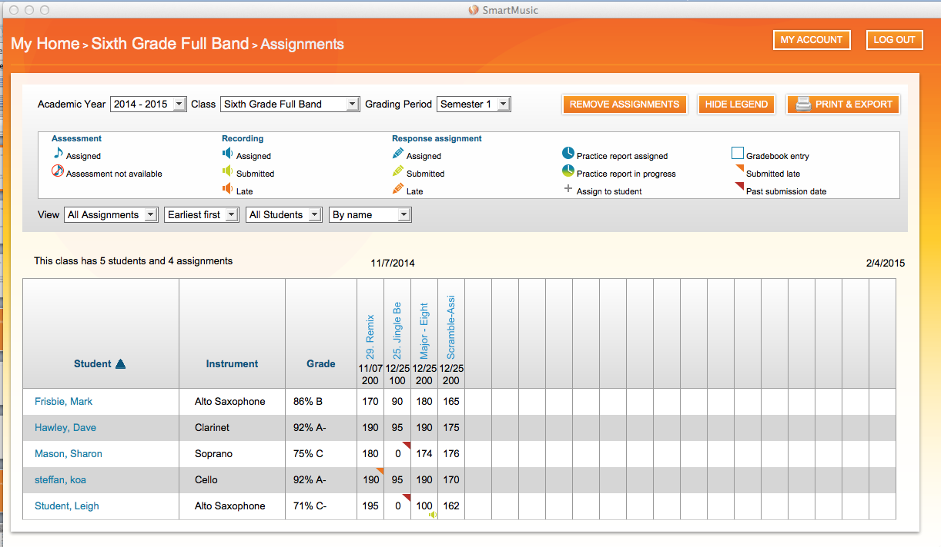
Notes:
When a student submits an assignment, it appears in your gradebook.

Slide 6
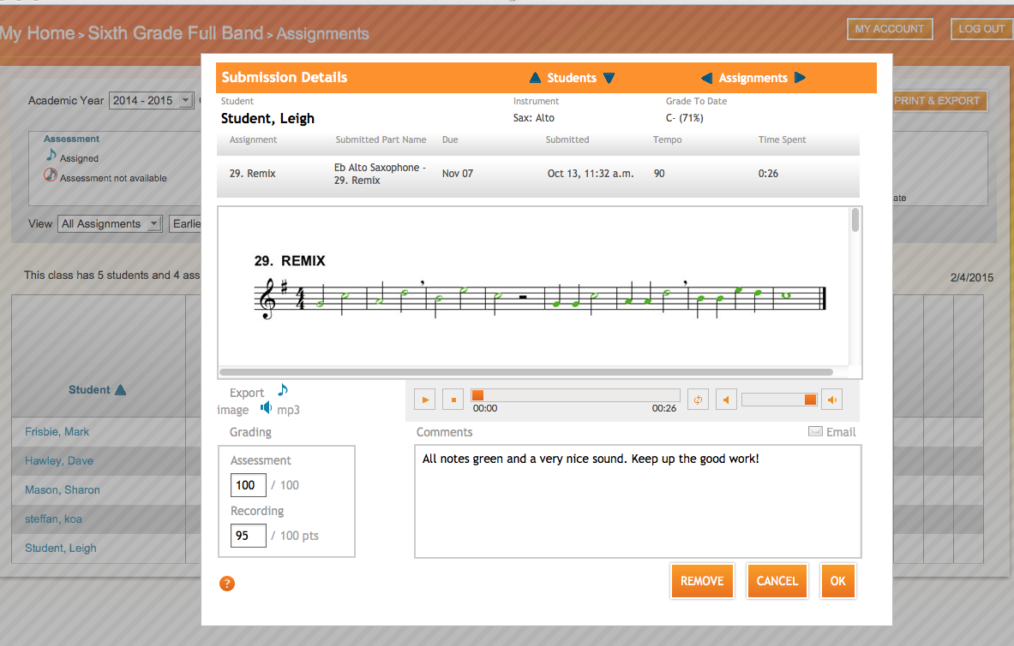
Notes:
SmartMusic automatically grades red and green note assessment for technique. Teachers grade recordings and make comments. Any assignment can be reassigned to the student. In addition, teachers can send an email to students and parents with a quick update on student progress.

Slide 7
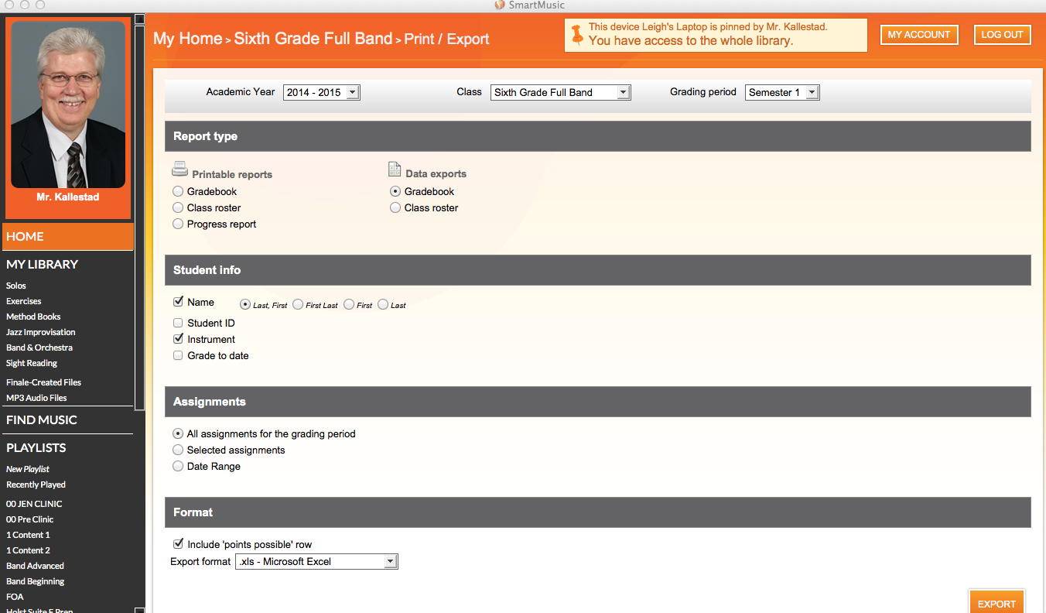
Notes:
Student grades and teacher comments can be exported from the SmartMusic gradebook as an excel file.

Slide 8
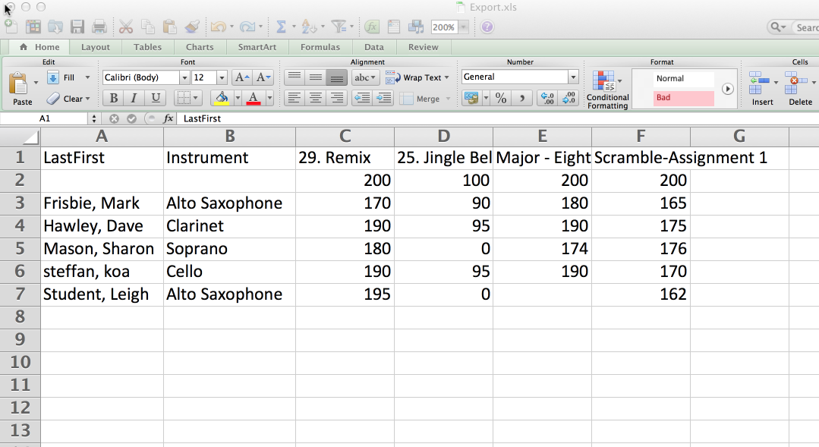

Slide 9
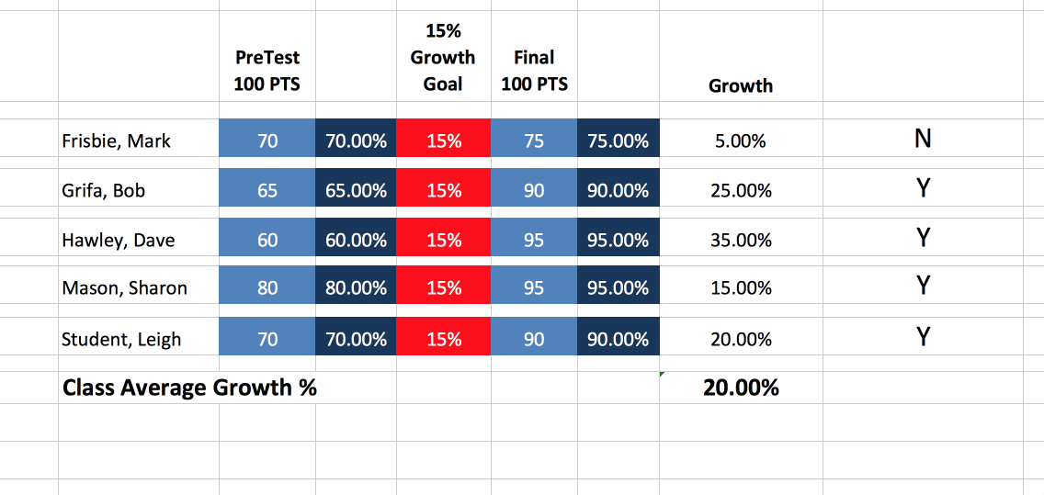
REPORT FOR ADMINISTRATION
Notes:
The exported data can easily be turned into reports for administrators. This example is pre-test, post-test, however formative and summative reports or time line reports are just as easy to create.

