Slide 1
Smart Music

Slide 2
What Is Smart Music?
Practice System for Instruments and Voice
  Extensive Solo Repertoire
  Exercises
  Method Books
  Jazz Improvisation
  Band and Orchestra Repertoire
  Finale Files
  Sight Reading Practice
  Classroom Management System
  Assessments

Slide 3
Show APPR Slide Show
Annual
Professional
Performance
Review
Provided by
Leigh Kallestad
MakeMusic
Education Services
lkallestad@makemusic.com
612-834-0850
By
Kevin Mead
Band Director
Churchville-Chili Senior High School
kmead@rochester.rr.com
585-729-3051

Slide 4
Show PA MEA SLO SmartMusic Slides
Provided by
Leigh Kallestad
MakeMusic
Education Services
lkallestad@makemusic.com
612-834-0850

Slide 5
Show Steve Goss SLOs
Provided by
Stephen Goss
Director of Bands
Ephrata Area school District
Ephrata, Pa 17522
S_goss@easdpa.org
724 426-6125

Slide 6
Show Dalinda Bohr SLOs
Provided by
Dalinda Bohr

Slide 7
Show Steve Goss Excel Spreadsheet
Provided by
Stephen Goss
Director of Bands
Ephrata Area school District
Ephrata, Pa 17522
S_goss@easdpa.org
724 426-6125

Slide 8
Subscriptions
$40 – Student
$140 – Educator
Click here for more information on pricing and plans.

Slide 9
HELP
http://www.smartmusic.com/onlinehelp/Desktop/smartmusic.htm

Slide 10
Music First

Slide 11
What is Music First?
Cloud-based collection of music software available on a couple of levels
  Student Version (several free web-based music applications)
  Classroom Version (all apps integrated into a course management system)
Applications
  Auralia (aural skills practice)
  Focus on Sound
  Groovy Music (Drag musical building blocks onto a timeline to compose)
  Inside Music
  Morton Subotnick’s Music Academy (Compositional activities)
  Music Delta
  Musition (Music Theory)
  NoteFlight (Notation Program)
  O-Generator (Play
  SightReading Factory
  Soundation

Slide 12
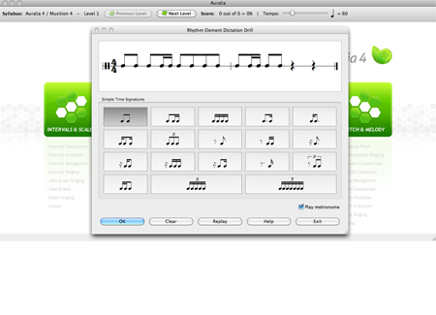
Music First Auralia
  Ear training

Slide 13
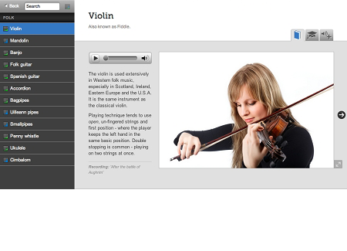
Music First Focus on Sound
  Introduction to Instruments and Sound

Slide 14
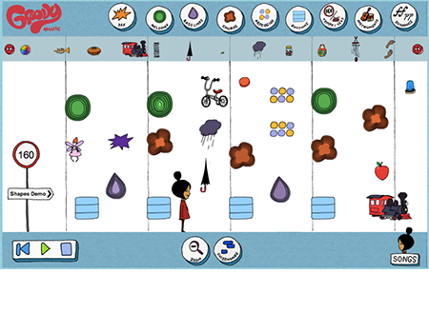
Music First Groovy Music
  Composition on a timeline with graphic musical building blocks

Slide 15
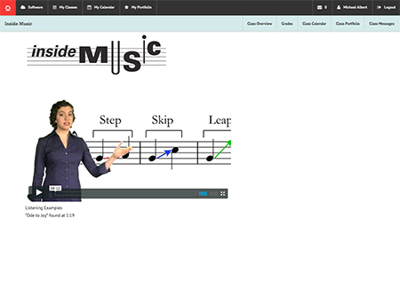
Music First Inside Music
  Composition Lessons

Slide 16
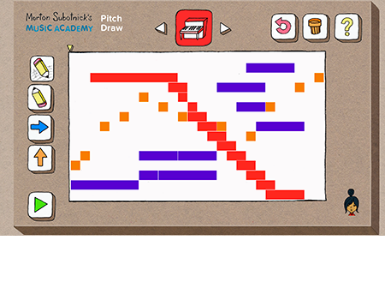
Music First Subotnick Music Academy
  Elementary Music Exploration and Games

Slide 17
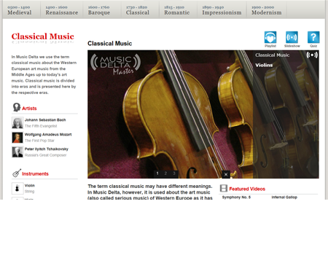
Music First – Music Delta
  Introduction to Music History

Slide 18
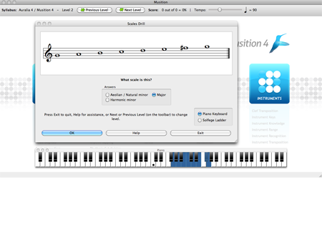
Music First - Musition
  Music Theory

Slide 19
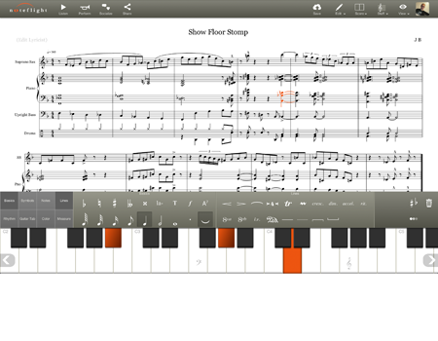
Music First - NoteFlight
  Music Notation and Composition

Slide 20
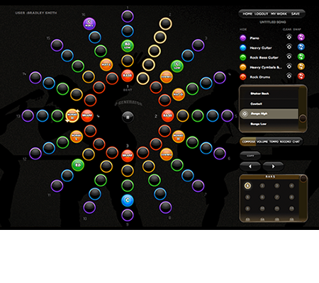
Music First - O Generator
  Compose by turning on and off various instruments in each measure (revolution)

Slide 21
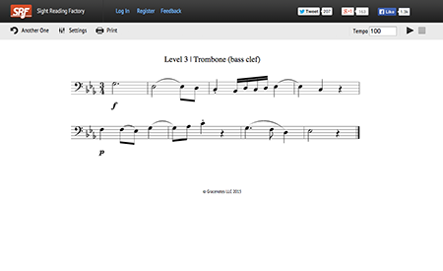
Music First – Sight Reading Factory
  Practice System

Slide 22
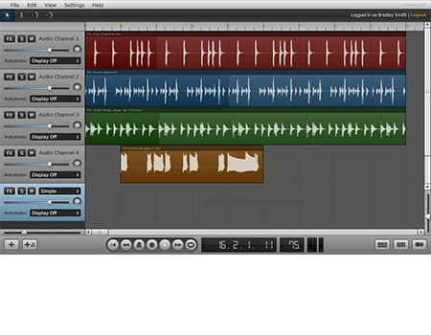
Music First - Soundation
  Like GarageBand, Mixcraft, etc., but it runs in a browser window.

Slide 23
Music First Classroom
Conventional multiple choice tests/assignments (free with classroom)
Method book lesson assignments (premade method book style)
Audio recording: free audio recording tool)
Video submissions: students can submit videos for assessment
Student portfolio of assigned/submitted work
Application Related Assessments
  Testing of aural skills using Auralia
  Music theory knowledge/tests Musition
  Notation exercises with Noteflight
  Sight reading with Sight Reading Factory
  Assessing practice: something like Smart Music
  Assesses pitch/rhythm of students’ playing

Slide 24
Music First Pricing
Many apps are free to student (without classroom)
Classroom with assessment features are licensed for as low as $2 per student

Slide 25
Music First Classroom Help
https://www.youtube.com/watch?v=7uc1bpssbnk
https://www.youtube.com/watch?v=2j-hNt3RuGw

Slide 26
Rubric
Show Bill Purse Rubric

