Slide 1
Avid Learning Partner Program
Andy Cook| Q2 2015

Slide 2

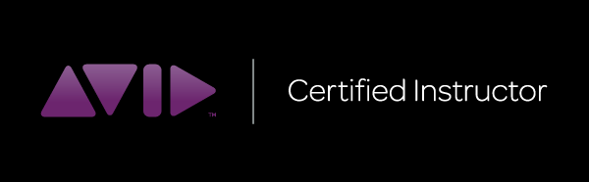
Avid Learning Partner Program Model
Avid Learning Partner schools
  Academic, Professional
    Launching in 2015: Online ALP
Avid Certified Instructors
  Trained & certified by Avid to deliver official courses at an ALP school, maintain “ACI” status for each new release

Slide 3
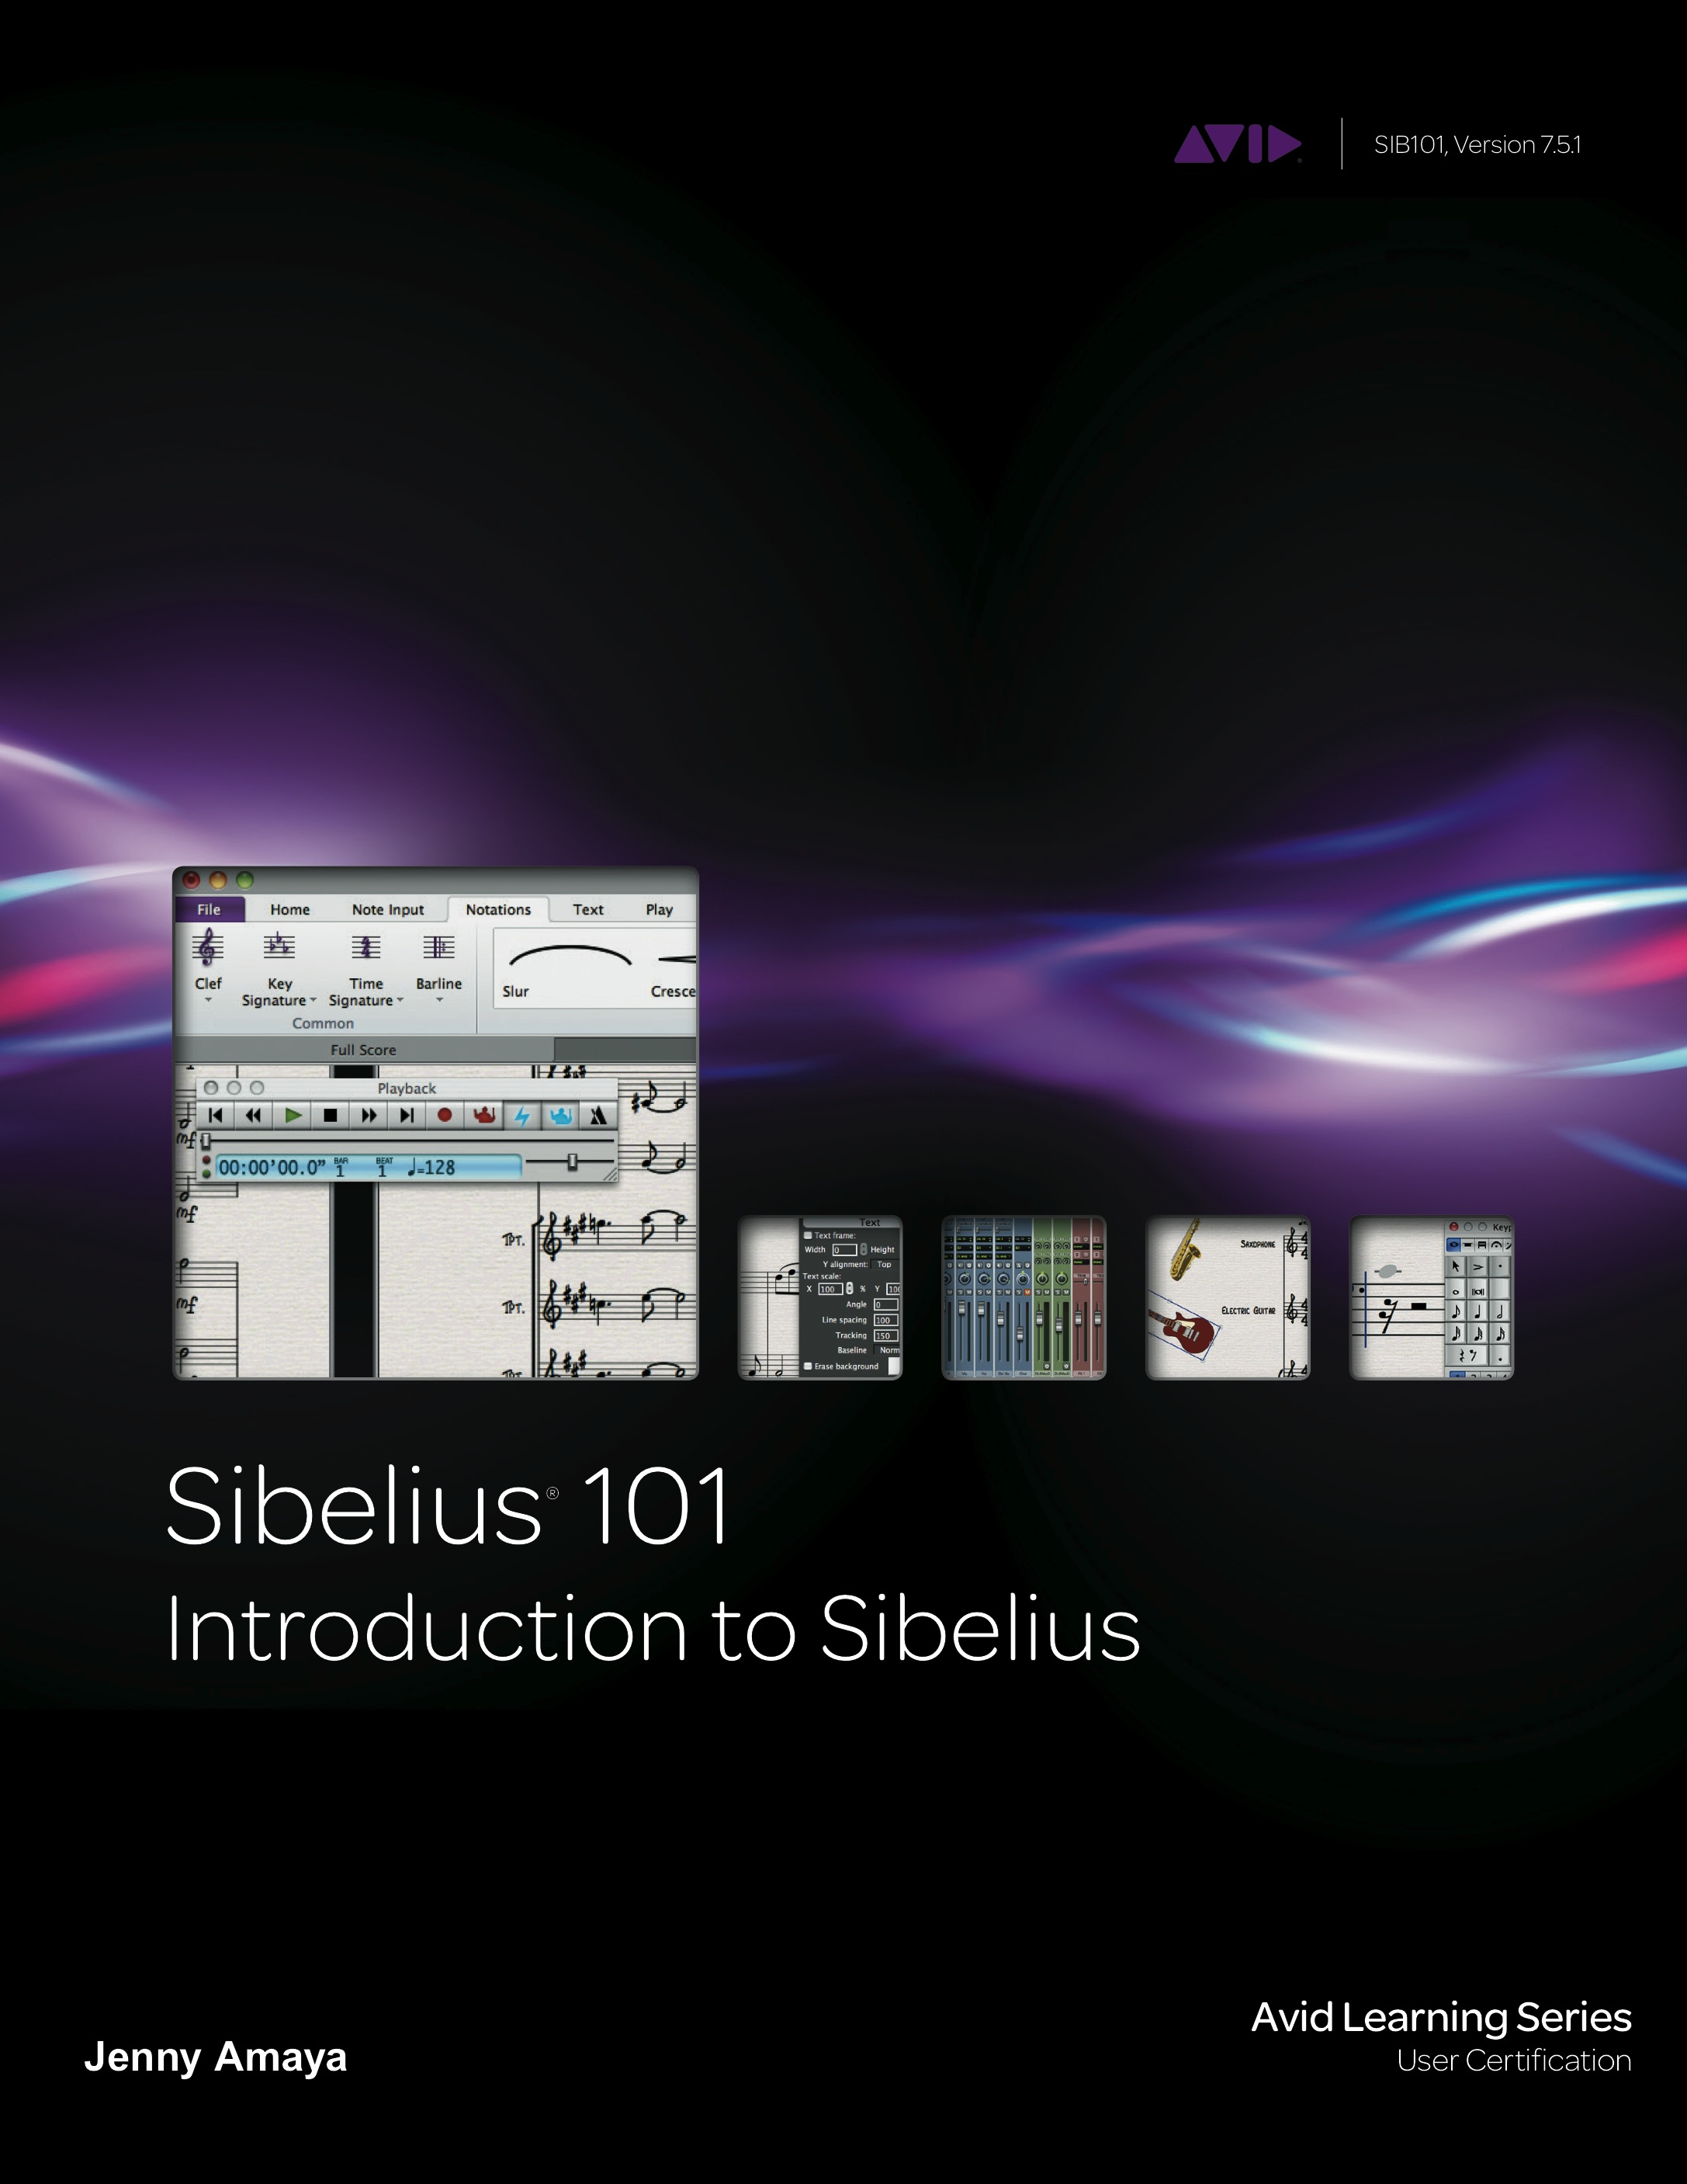

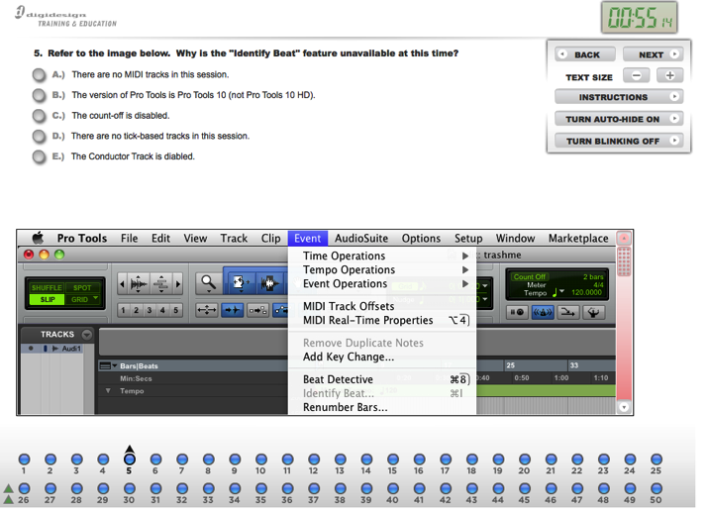
Avid Learning Partner Program Model
Avid Course Materials
  Official books, eBooks, Instructor Guides, PowerPoint slides for each chapter, hands-on media projects, supplemental videos
Course, Exam, & Cert Mgmt System (TAT)
  Downloading/ordering of course materials
  Administer online exams
  Manages wide variety of certification listings (User, Operator, Professional, Expert, Instructor)

Slide 4
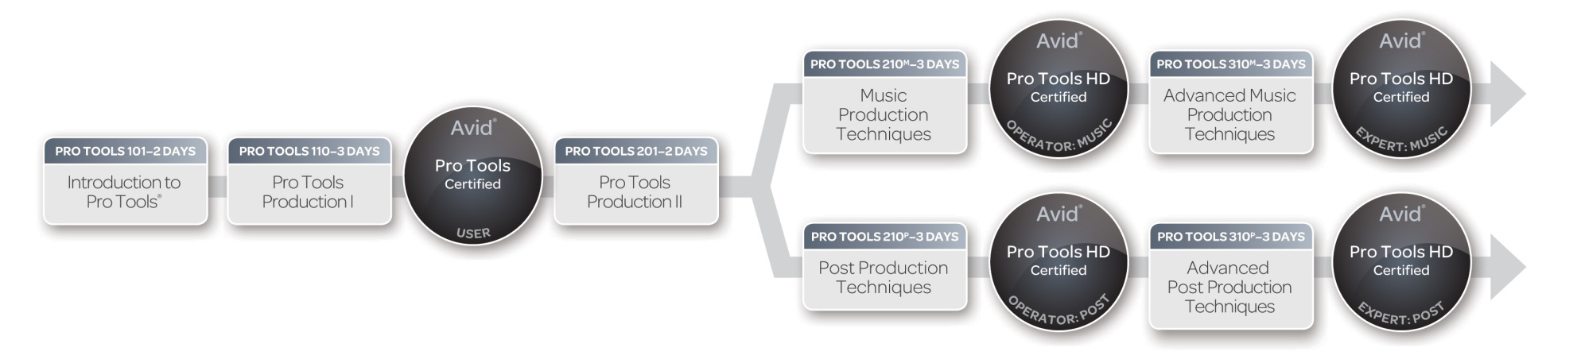
Pro Tools Course & Certification Path
Levels
  100-level: Pro Tools 12 software (Mbox/interface optional)
  200-level: Pro Tools HD Native, professional music & post workflows
  300-level: Pro Tools HDX, DSP, mixer architecture, adv. music & post workflows

Slide 5
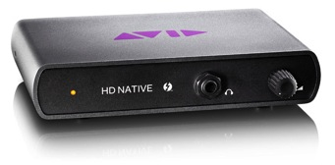
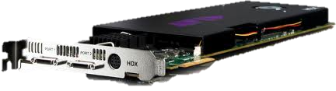
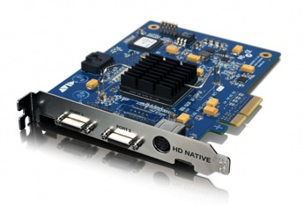
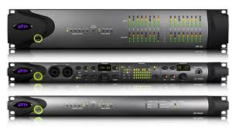
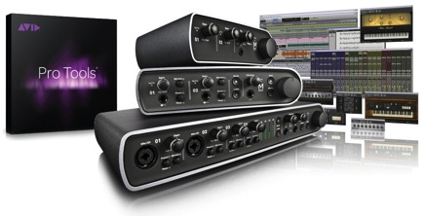


Pro Tools Course & Certification Path
Levels (continued)
300-level Pro Tools HDX
Certification
(Pro Tools|HD Native
Thunderbolt or PCIe)
200-level Pro Tools HD
Certification
100-level Pro Tools
Certification

Slide 6
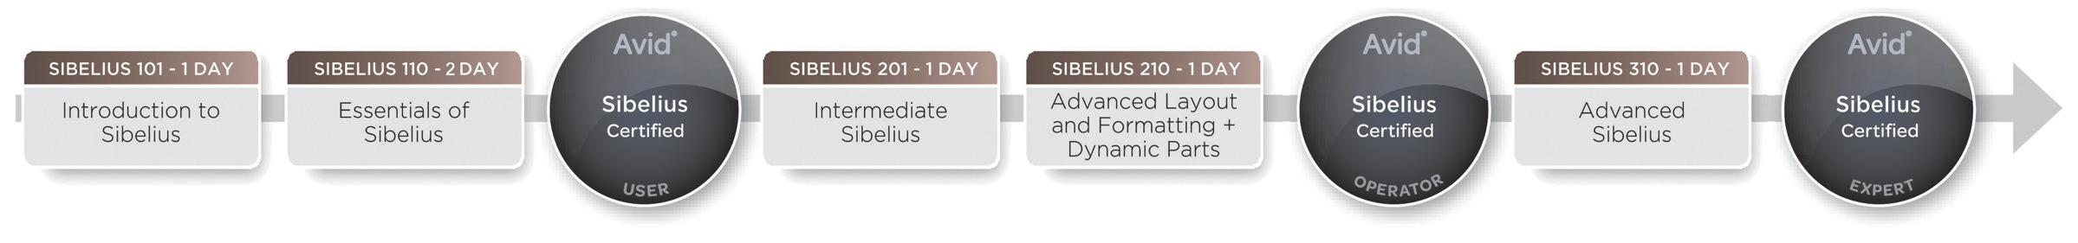
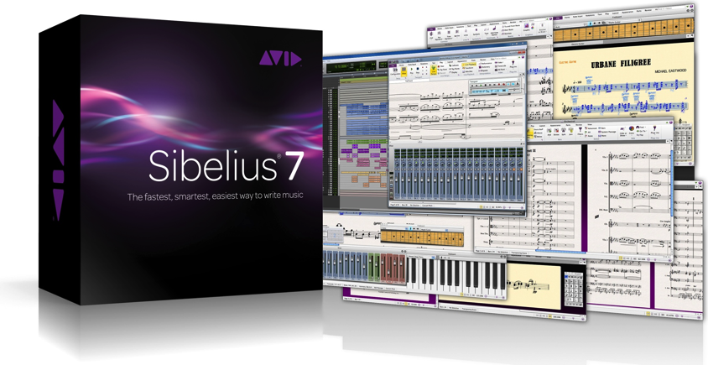
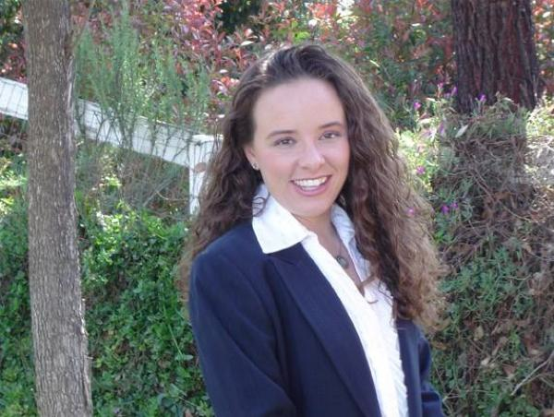
Sibelius Course & Certification Path
100-Level Course Structure
  Sibelius 101 Book & Exam (8 hrs)
  Sibelius 110 Book & Exam (16 hrs)
  Online exam at account.avid.com
  )

Slide 7
Certification Exam

Slide 8
Certification Search
Certified Professional Listing on avid.com

Slide 9
Certification Listing
Edit Certified Professional listing

Slide 10
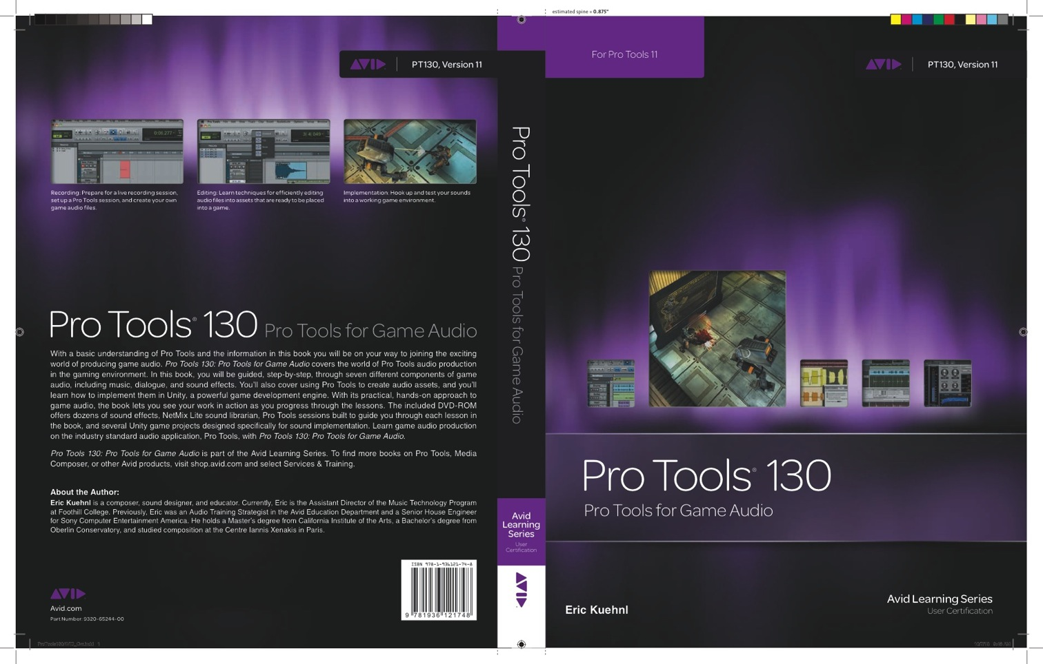

Game Audio Certification Course
PT 130 Game Audio
  Eric Kuehnl authoring
  Adding Certification
  Future Expansion
    Collaboration w/ FMOD Studio courses & cert

Slide 11
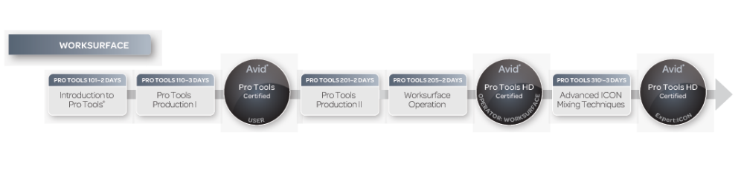
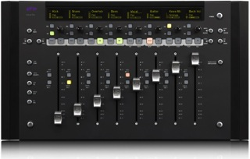
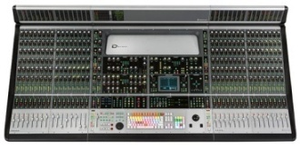
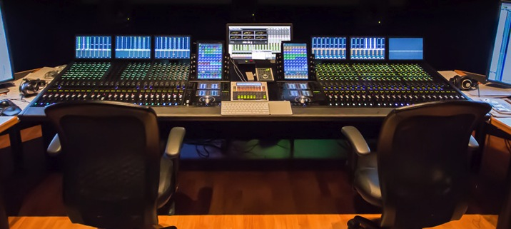
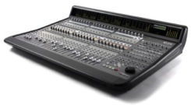
Console Course & Certification Path
300-level Icon, Avid S6
Certification
200-level Artist, S3
& C|24 Certification
100-level Pro Tools
Certification

Slide 12
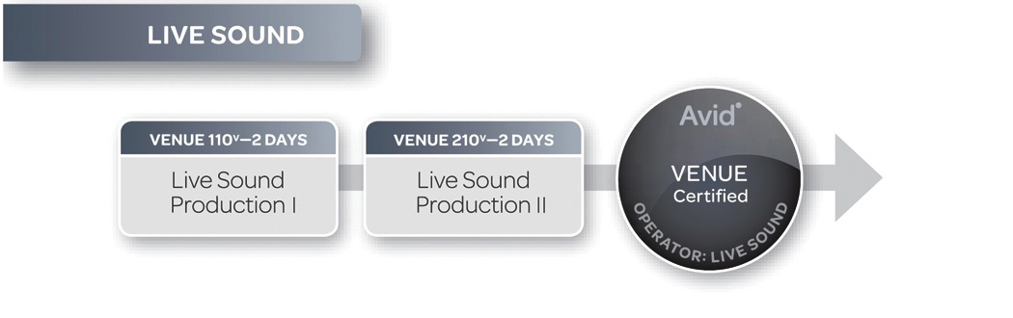
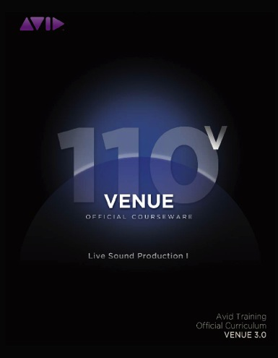
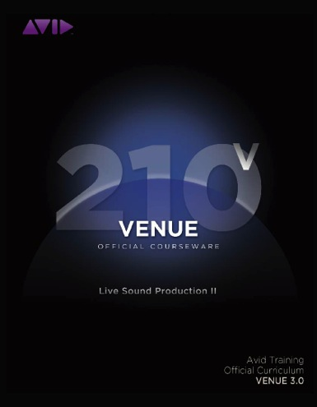
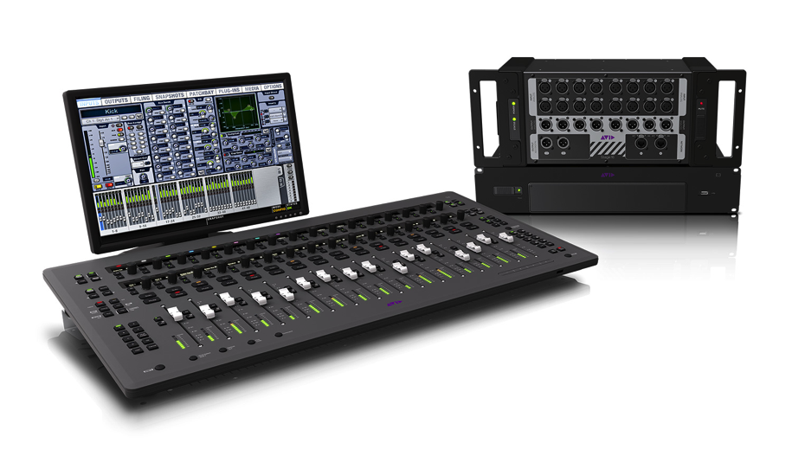
Avid Live Sound Course & Certification Path

Slide 13
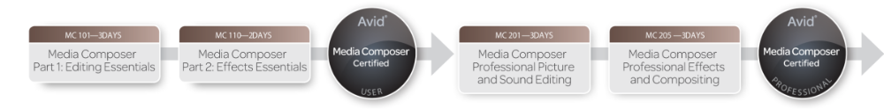
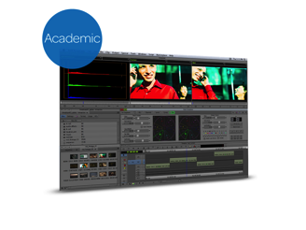
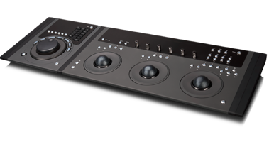
Media Composer Course & Certification
239 Color Correction
Course
Future 300-level MC
Certification
200-level Media Composer
Certification
100-level Media Composer
Certification

Slide 14
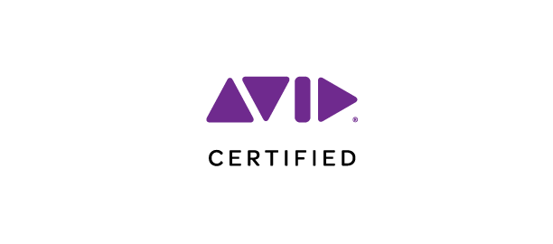

Slide 15


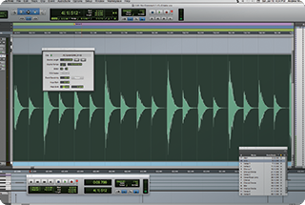

Pro Tools | First
3 cloud projects
16 audio, instrument and MIDI tracks
21 AAX plug-ins
Xpand2 virtual instrument

Slide 16
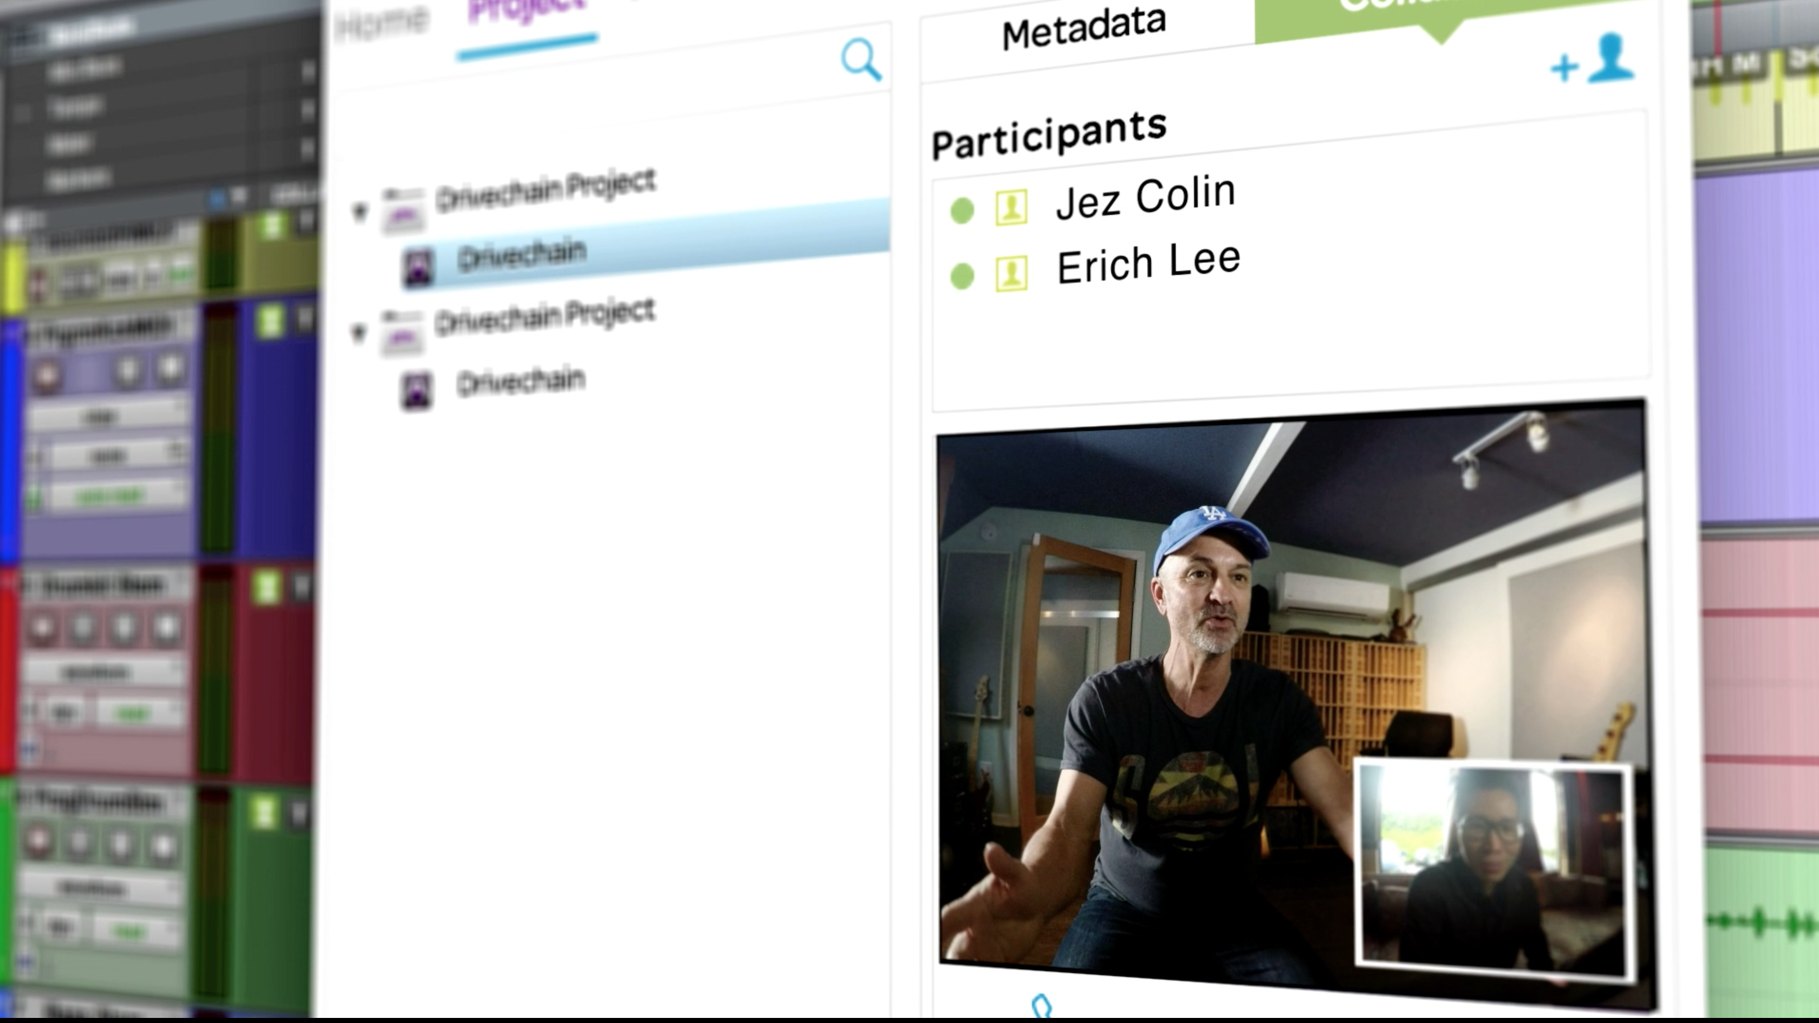
Avid Cloud Collaboration
& Pro Tools 12
Buy or subscribe—the choice
is yours
Always stay up to date with the latest features
Collaborate with anyone, anywhere

Slide 17


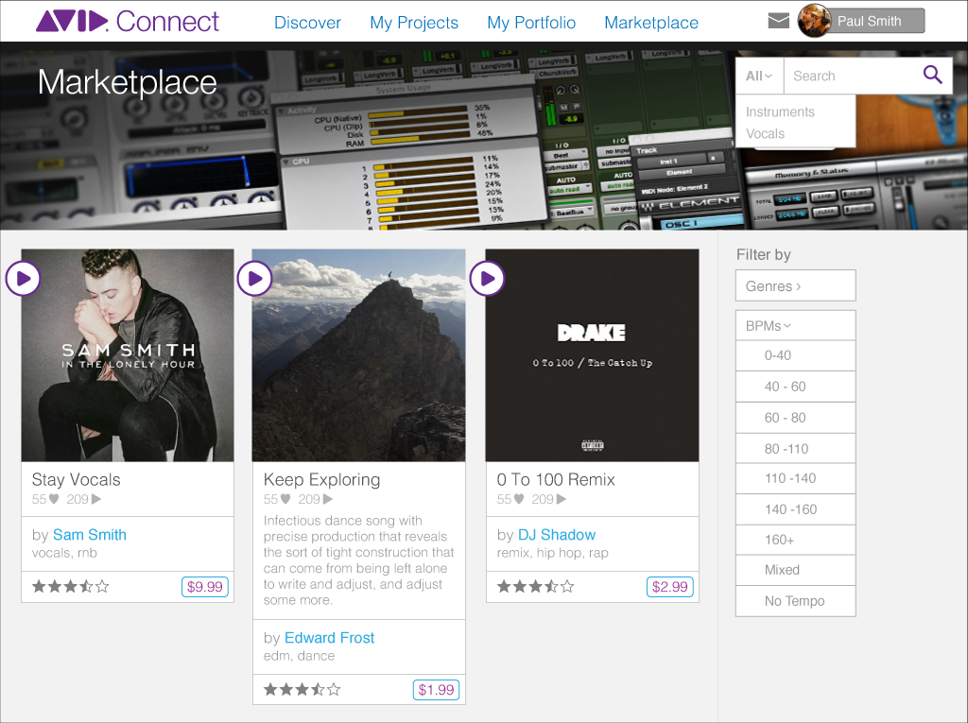
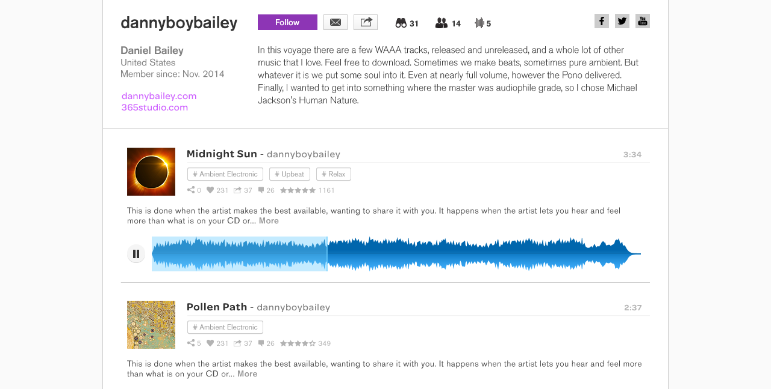

Avid Marketplace
Artist
Community
Avid App
Store
Storage
Avid Content
Marketplace

Slide 18
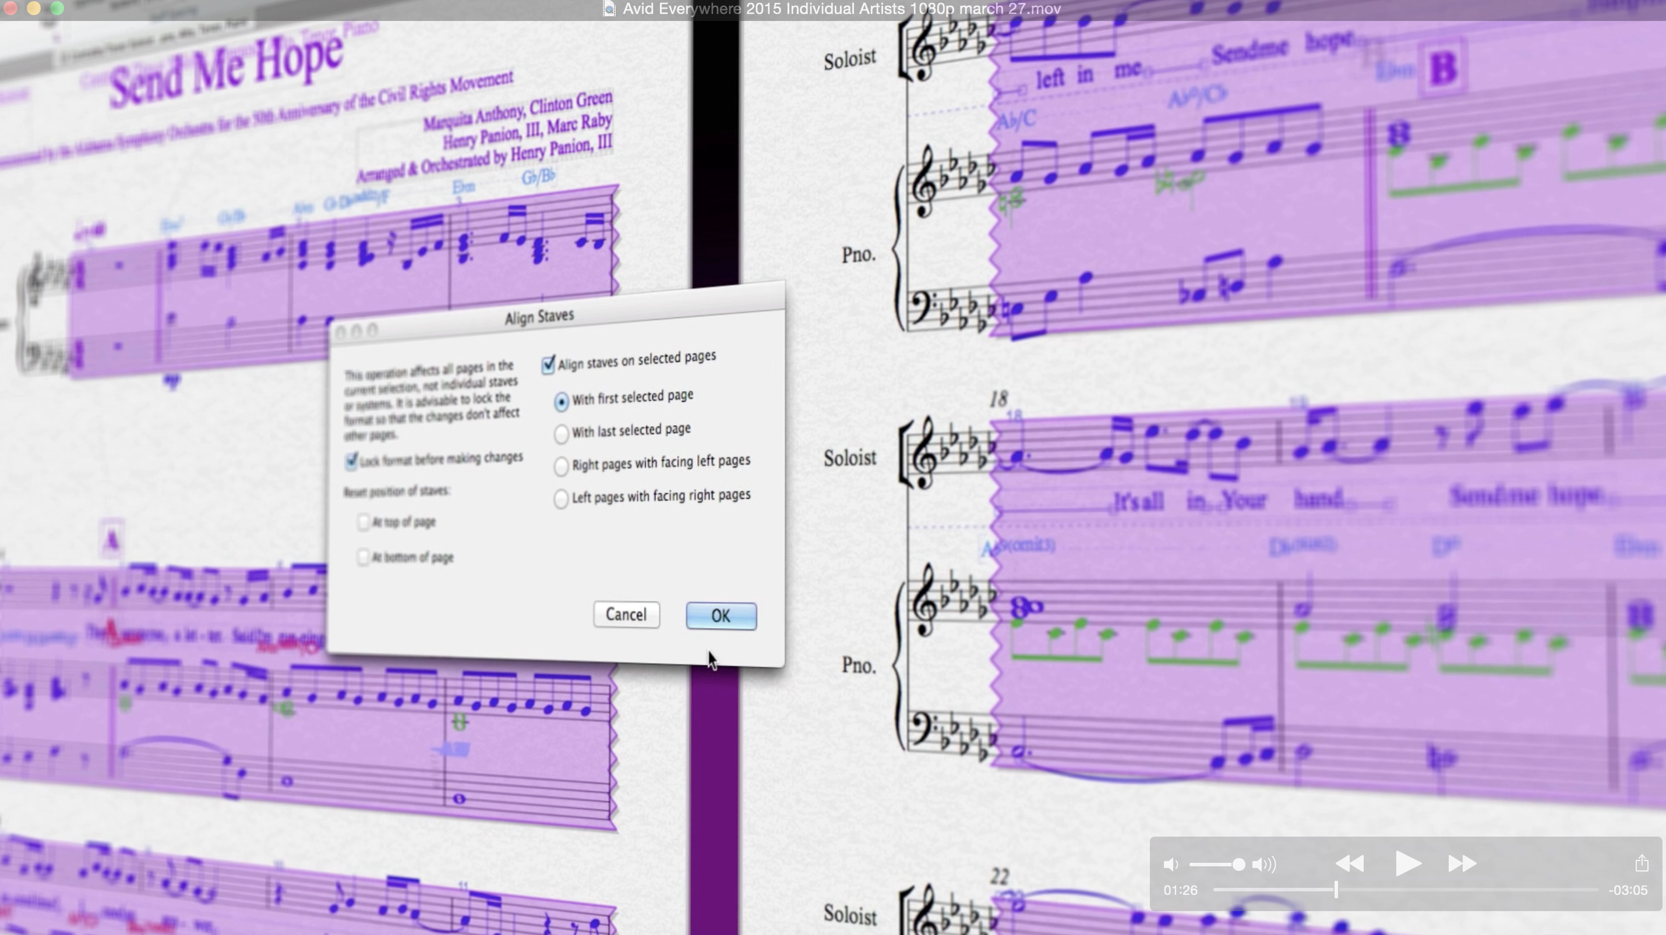
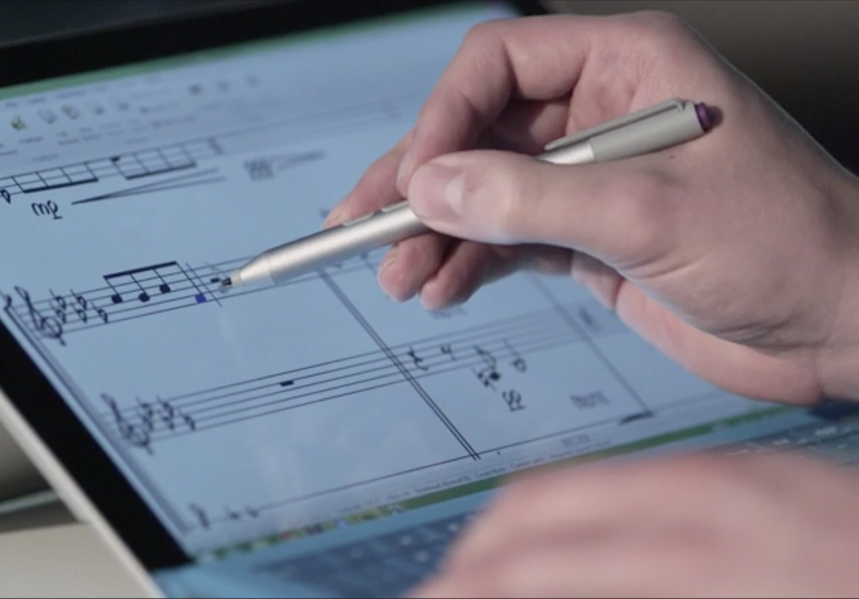
Sibelius
Raise your score
Buy or subscribe—the choice
is yours
Enhance remote classroom experience with in-score annotation
Leverage mobile technology with multi-touch gestures and pen input with Surface Pro

Slide 19
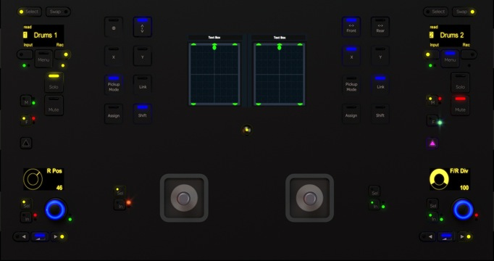
Pro Tools | S6
Mixing Redefined
Revolutionary modular design
Superior ergonomics
Intelligent studio control
Proven and trusted technology
New Joystick Module

Slide 20
Avid Contact Info
Andy Cook
Learning Partner Program Manager | Avid Education
Avid
San Francisco, CA
United States
andy.cook@avid.com
+1 415 609-5372

